Slide 1

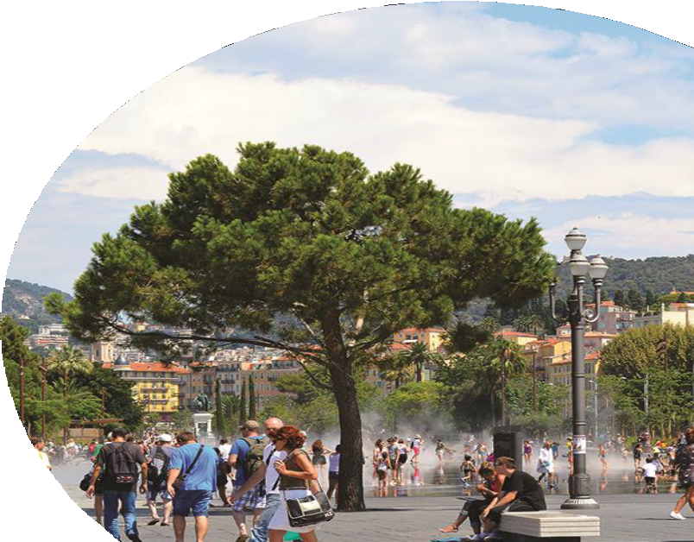

URBACT IV network application
Sharing best practices for implementing the 17 Sustainable Development Goals (SDGs) at the municipality level
Presentation to interested cities
1
Notes:
Lancement de la présentation : CUD

Slide 2
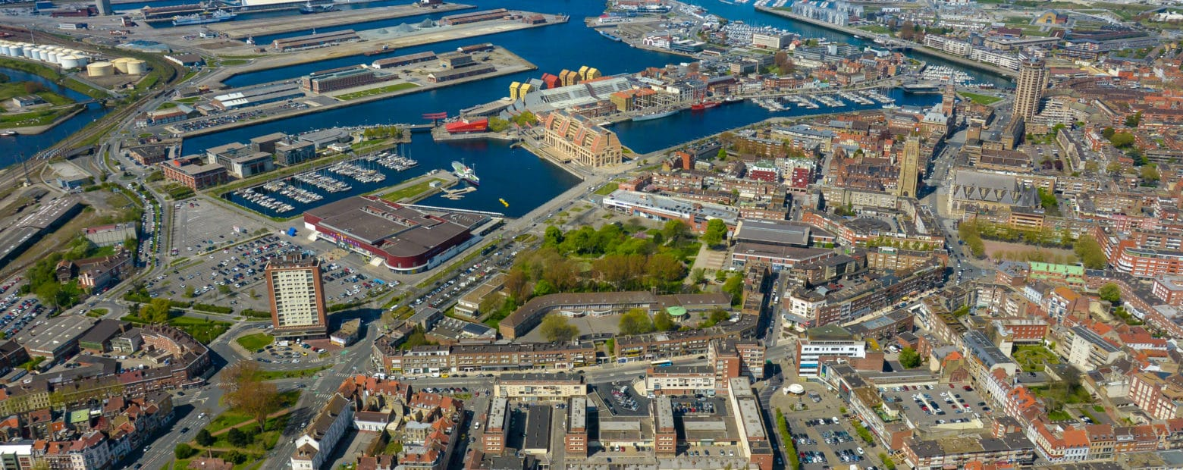

WELCOME !
2013
2017
2021
1
Notes:
Introduction de Sylvie

Slide 3
Our URBACT IV project in a nutshell
2
Notes:
CUD

Slide 4
Why are we reaching out ?
Greater Dunkirk is heavily investing into its ecological transition
Coastal territory adapting industrial port activity, energy platforms and natural assets to climate change
Pilot urban area that co-developed an evaluation framework to help integrate the 17 SDGs across all local policies
Want to challenge and improve this holistic approach by sharing its methodology with other European municipalities
r
3
Notes:
CUD team leader – mettre en contexte

Slide 5
What are we looking for?
Greater Dunkirk is willing to become the Project coordinator (“Lead Partner”)
  Allocate sufficient human resources (PMO, finances, communications…)
  Submit the network application
We are looking to identify 7 to 9 cities from eligible European countries willing to join the network (“Project Partners”)
  70% less developed regions/ 30% more developed regions as defined by EU
During the project (2023-2025), each partner city is expected to:
  Help us identify city challenges, tools and best practices
  Codesign a shared framework based proven tools (ISO, RFSC, EEA, SSCA…)
  Use this framework in the elaboration of a local Integrated Action Plan (IAP)
  Provide feedback on the results and help formulate recommendations for future actions
5
Notes:
CUD - donner une perspective

Slide 6
Contact us
Sylvie Delatte
Director of Territorial development and partnerships, Great Dunkirk
Pilot City
Email : sylvie.delatte@cud.fr
Notes:
CUD à confirmer

