Slide 1
The Storyteller City
How to use storytelling to engage citizens in local projects
19 November 2025

Slide 2
Story is king (or queen)
From a reliable source …

Slide 3
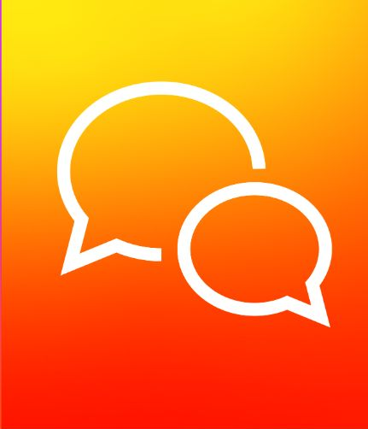
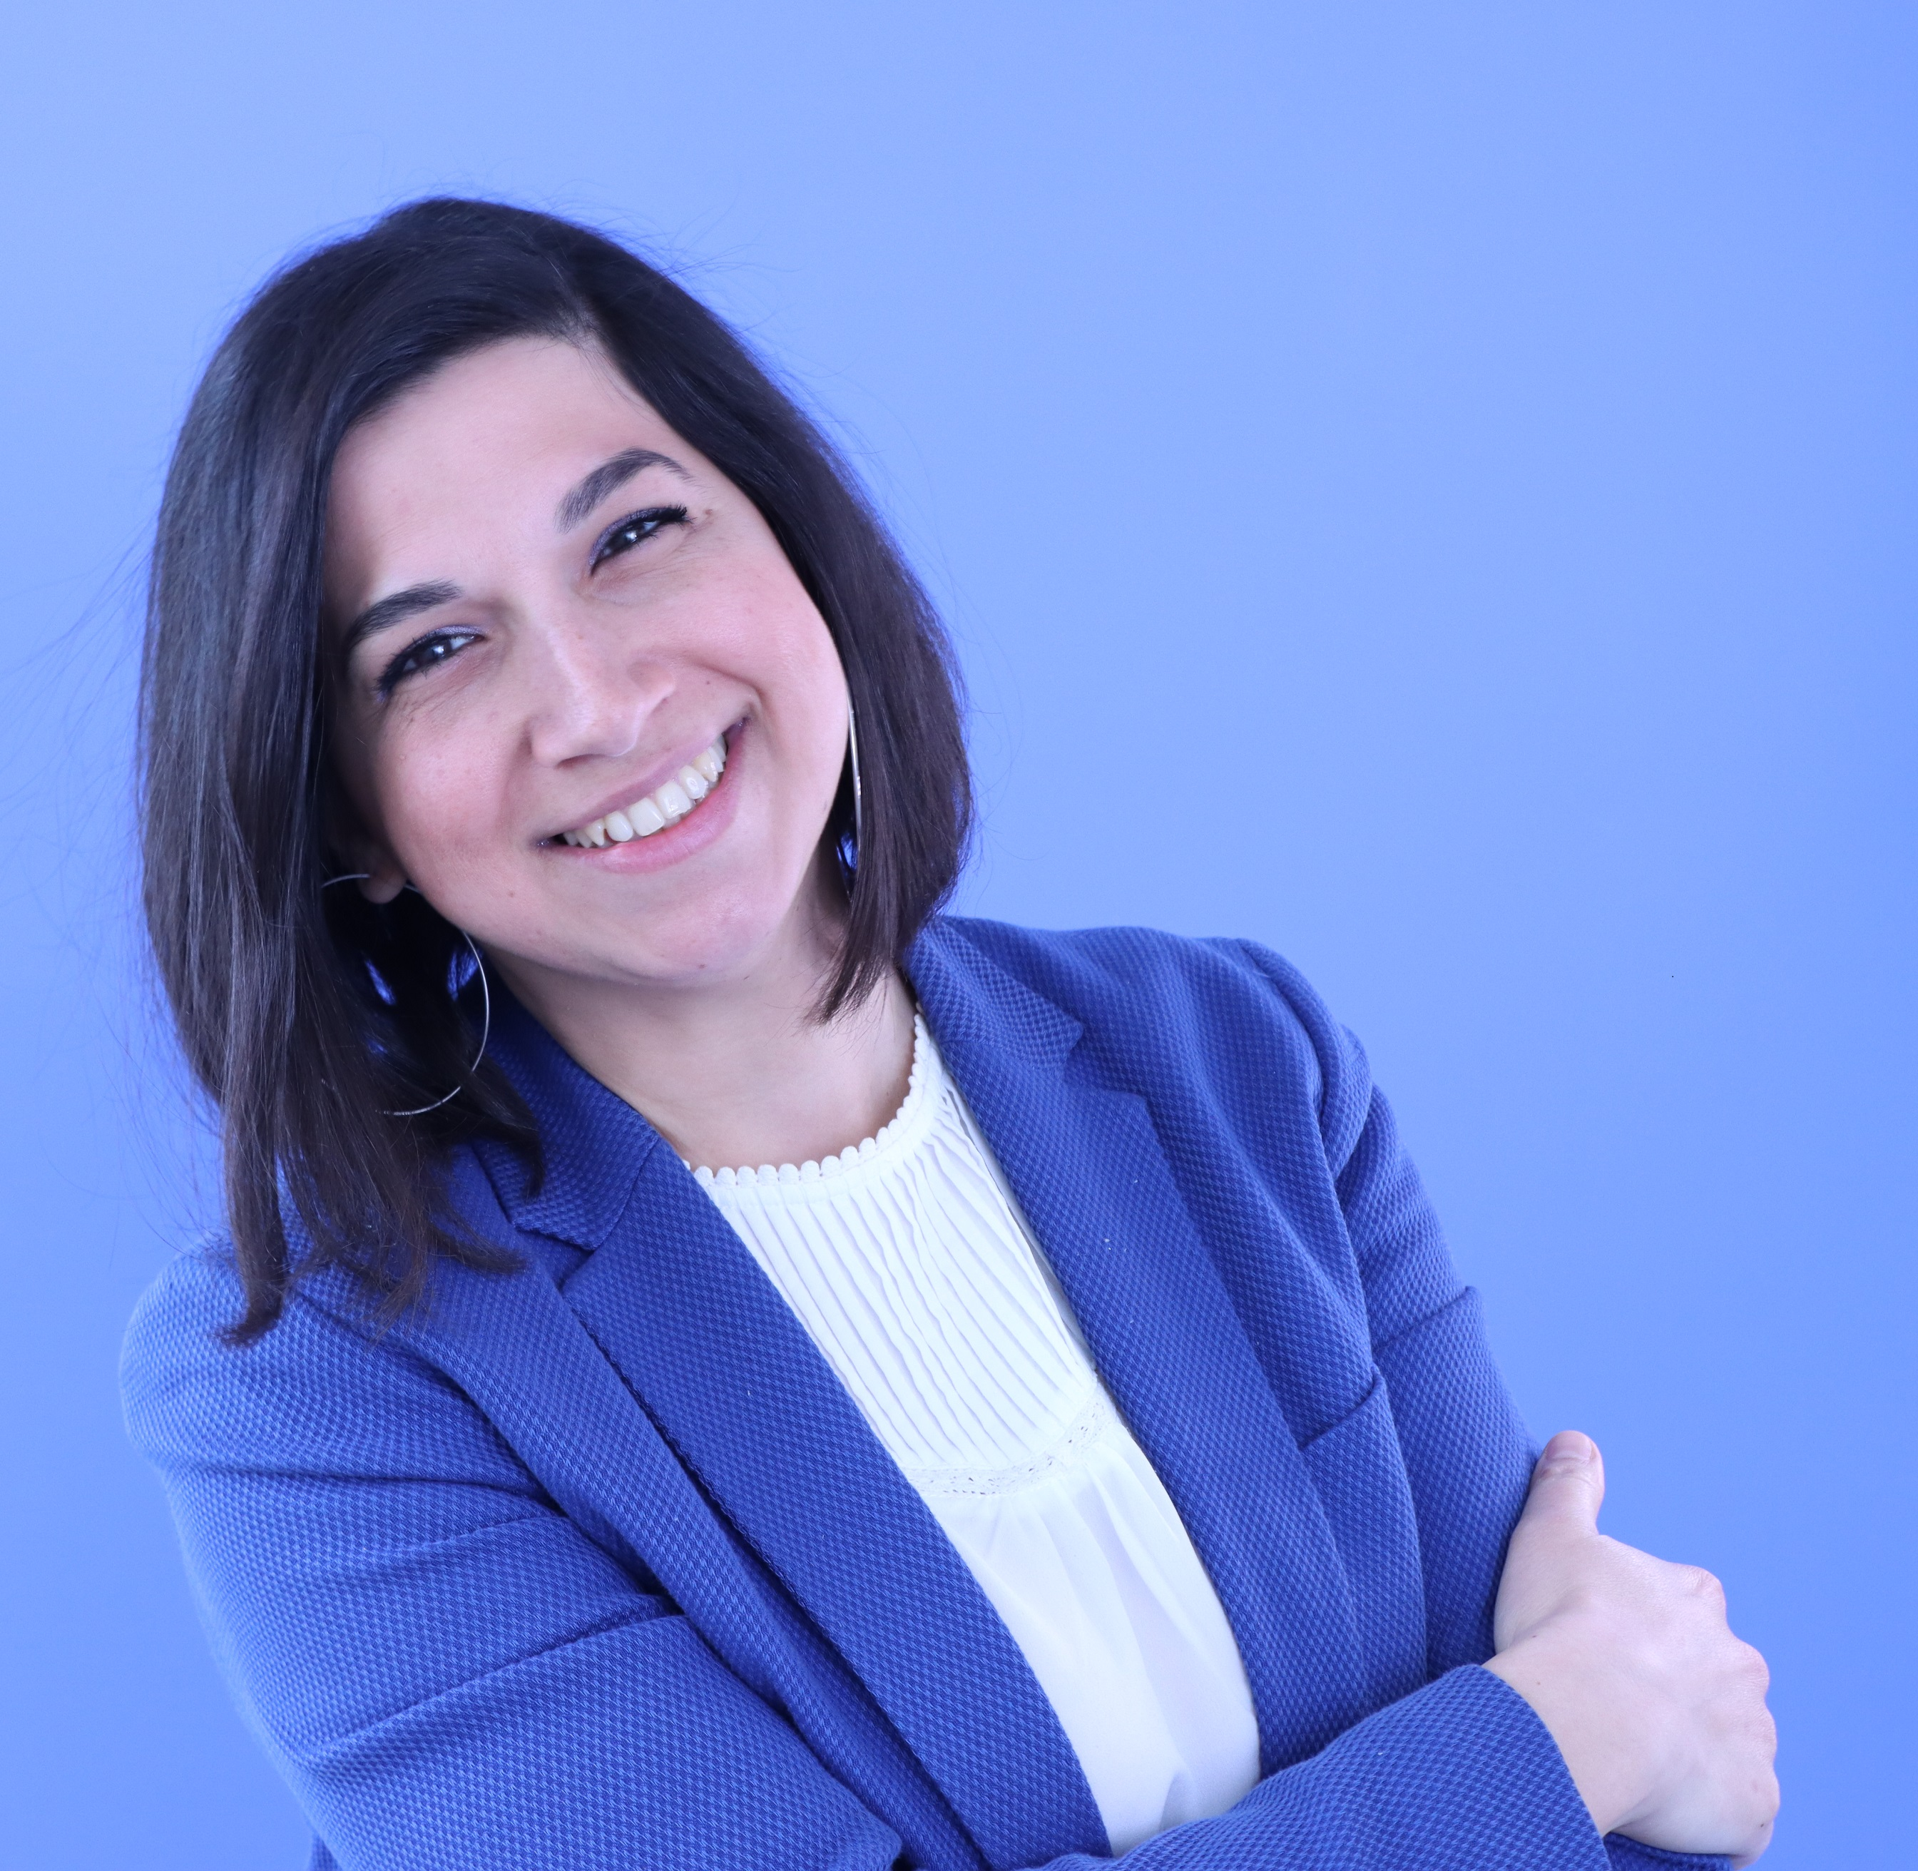
Jenny Koutsomarkou,
Head of Unit Communication & Knowledge, URBACT Secretariat

Slide 4
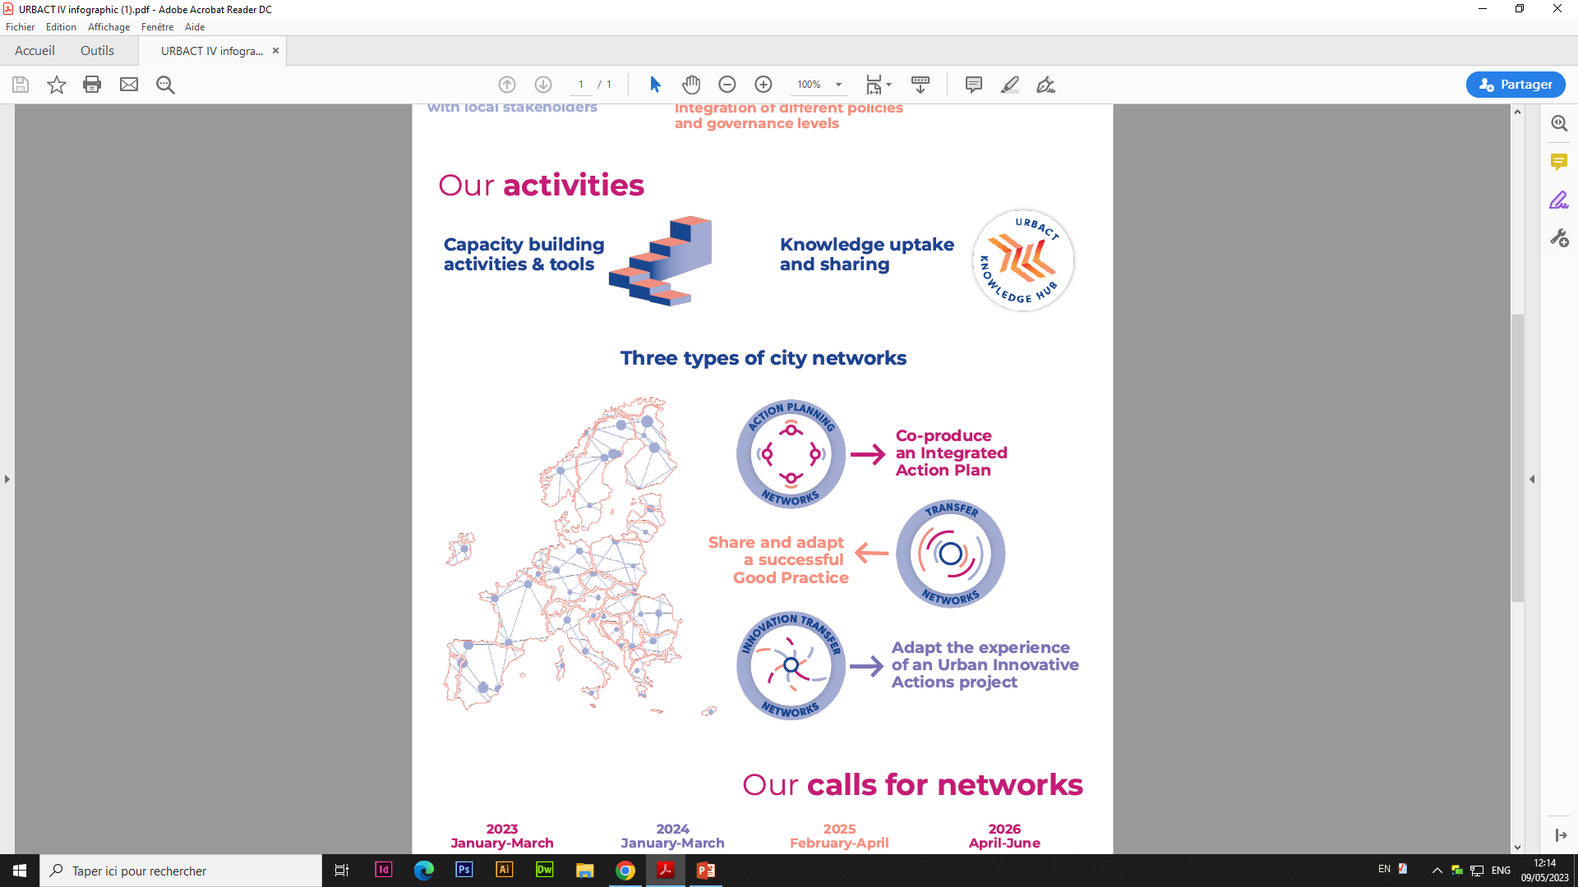
URBACT IV-- the EU-funded programme dedicated to the cooperation of European cities
Networks of European cities
Since 2023,
65 networks, 525 partners,
32 countries

Slide 5
Why this webinar?
-How to use/adapt storytelling in an urban context
-To equip city administrations with storytelling tools and techniques for local policy-making

Slide 6
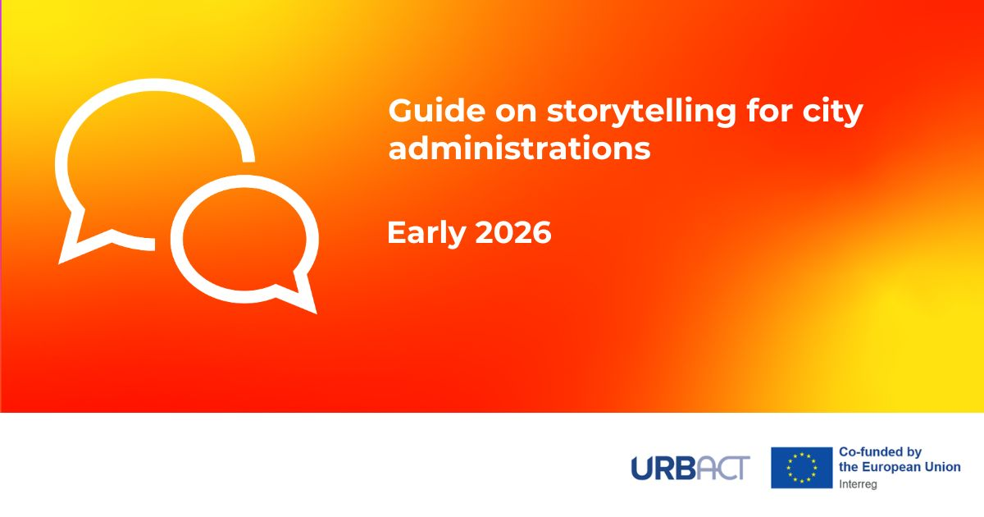

Slide 7
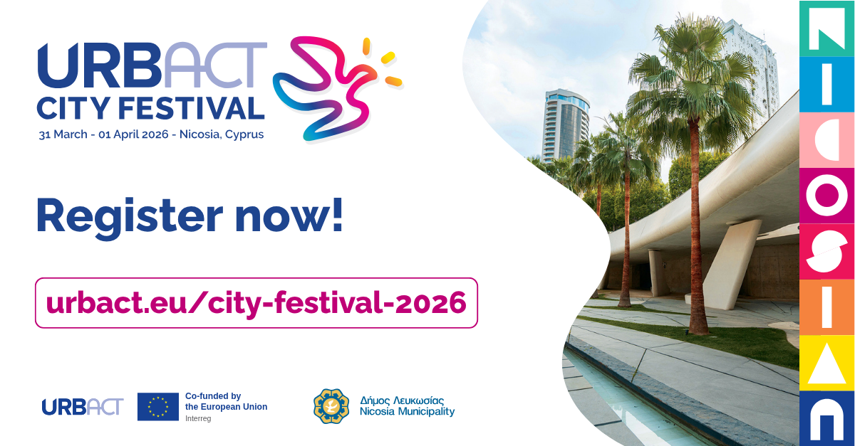

Slide 8
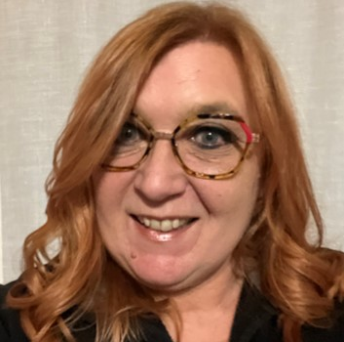
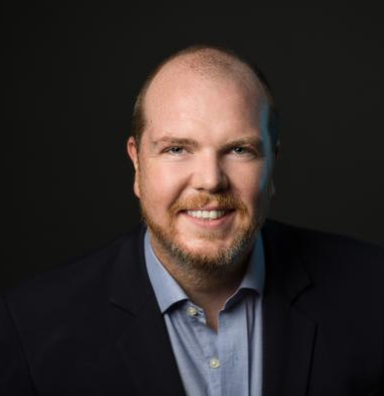
Featuring
Sandra Rainero
Brian Marrinan

Slide 9
FEATURING … Cities involved in URBACT networks
City of Altea (ES), Paloma Verdù
City of Getafe (ES), Fernando Gonzalez Ferreira
City of Ravenna (IT), Emanuela Medeghini

Slide 10
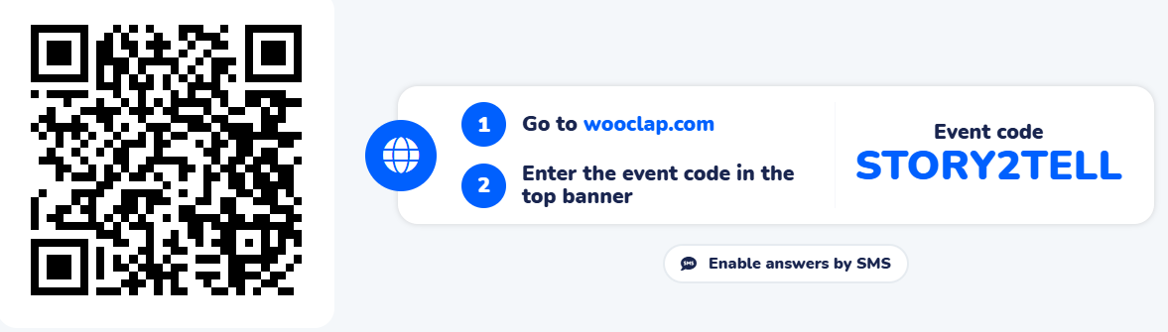
How to engage with us?
1. Through Wooclap
2. Through Questions & Answers option on ZOOM

Slide 11

Once upon a time….
Storytelling involves sharing social information through various forms, including spoken, written and symbolic languages
Storytelling is a key way we learn and make sense of the world
Old man: If you knew the story so well, what did you need me for?
Girl: To listen
The Witcher –Season 4
Notes:
Storytelling is about social information and exchange.
It encompasses all kinds of languages and expressions, be they oral, written or symbolic
The concept of citizens is a social construct, so – the underlying message throughout our webinar, the experiences that cities will share is that you need to understand the diversity of your citizens. Age, gender, identity, socio-economic status, education, background, level of power and interest,

Slide 12
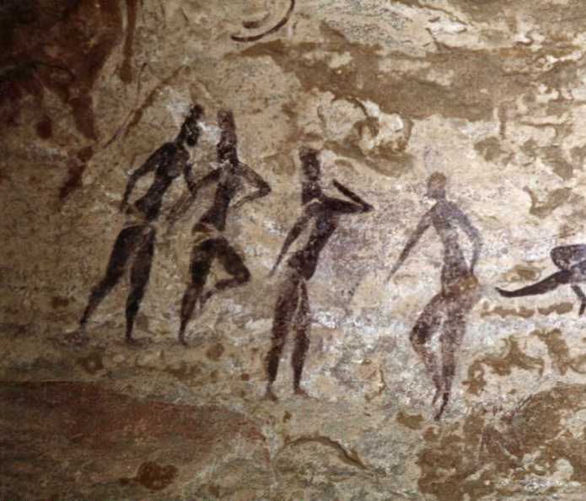
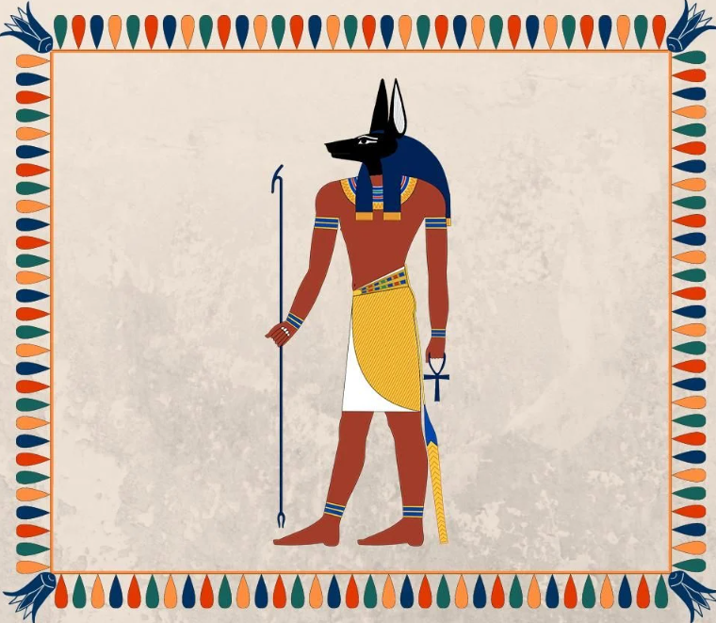
Since the dawn of mankind…
Our brain interprets the environment to build a world model
Curiosity and self-awareness drive our survival and adaptation
Need to “control the narrative”
Notes:
Our neural brain works through a neural network to make sense of the surroundings (survival instinct of our species) and create a model of the world - the diversity of your citizens (and you are or should be the experts on that) reflects the diversity of the “world model” they have
in other words …through storytelling….
We like to gossip
We like to show off
We are not the strongest, fastest or best sighted species…
We survive and evolve through curiosity (which killed some cats) – our way to (try to) control the environment , and through a higher sense of self (Narcisus)

Slide 13

Stories are all about connections
For Sale:
Baby shoes
Never worn
We connect words or images to form a coherent story
We tend to find cause-effect links even if none exist
Notes:
We always look to create connections (cause-effect) even when they are not there
That is why when we have six words, we tend to create connections between them, even when there might be not connections and, in that way, we end up with …a story that makes sense Good storytelling uses these connections
For sale: baby shoes, never worn

Slide 14
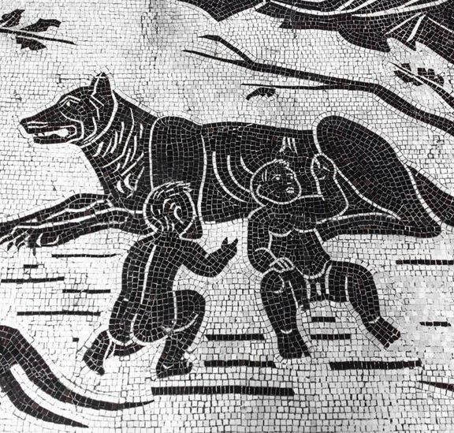
From around the campfire to cities …. STORIES
Revolve around CHANGE/ TRANSFORMATION
Reflect culture, memories, values and behaviors
Build connections but also define boundaries
Notes:
Each of us needs to control the projection of the world
We all need to survive the “change” (by making sense of it- all stories are about CHANGE)
Storytelling creates bridges but also borders, communities and enemies – what is acceptable or not acceptable – it creates habits and norms
Storytelling also shapes the urban environment
Storytelling (a form of play) is the primary form of learning and making sense of the world
We communicate to infants and kids through storytelling
We remember our dead through storytelling
Stories help create a model of the world – compatible with ours (our culture, our memories, our habits, our values, our behaviors)

Slide 15
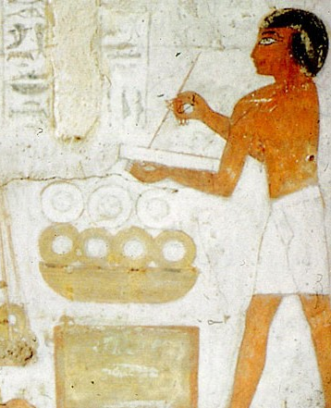
Stories: from magic to science
Stories are one of the oldest technologies used by humankind
Many scientific disciplines help framing stories, also in urban settings
Notes:
Since the Greek philosophers but especially over the past two centuries, the power of stories has become the focus of many disciplines, each explaining why they move us, and helping frame them also in the urban setting

Slide 16
ACCORDING TO … STORIES ….
Ethno/anthropology
Sociology
Psychology
Behavioral Science
Neuroscience
Transmit culture and shared identity
Bind communities and shape movements
Help us process experience and build empathy and cognition
Influence perception, decision-making and action more than data alone
Light up multiple areas of the brain, we feel them as if they were real

Slide 17
Storytelling … in URBACT style
Above and beyond the delivery of stories to engage citizens

Slide 18
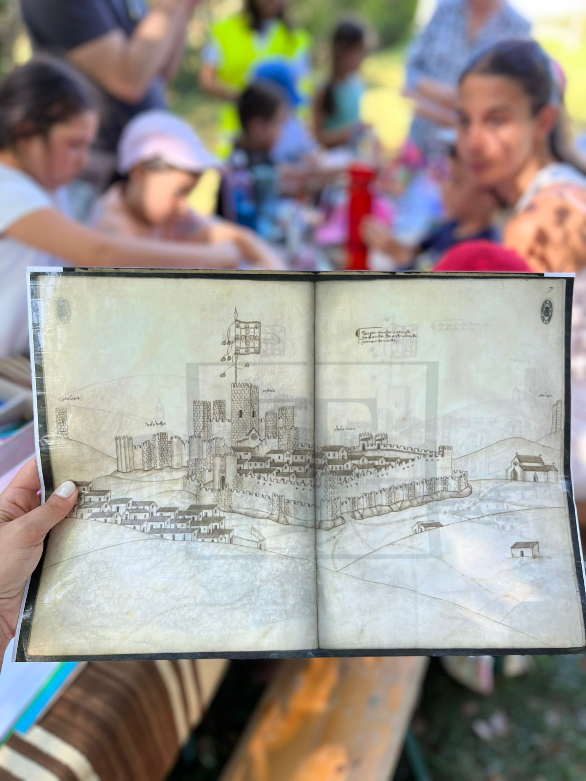
Participatory and action learning approaches to storytelling in cities
Story-telling
Story-making
Story-doing

Slide 19
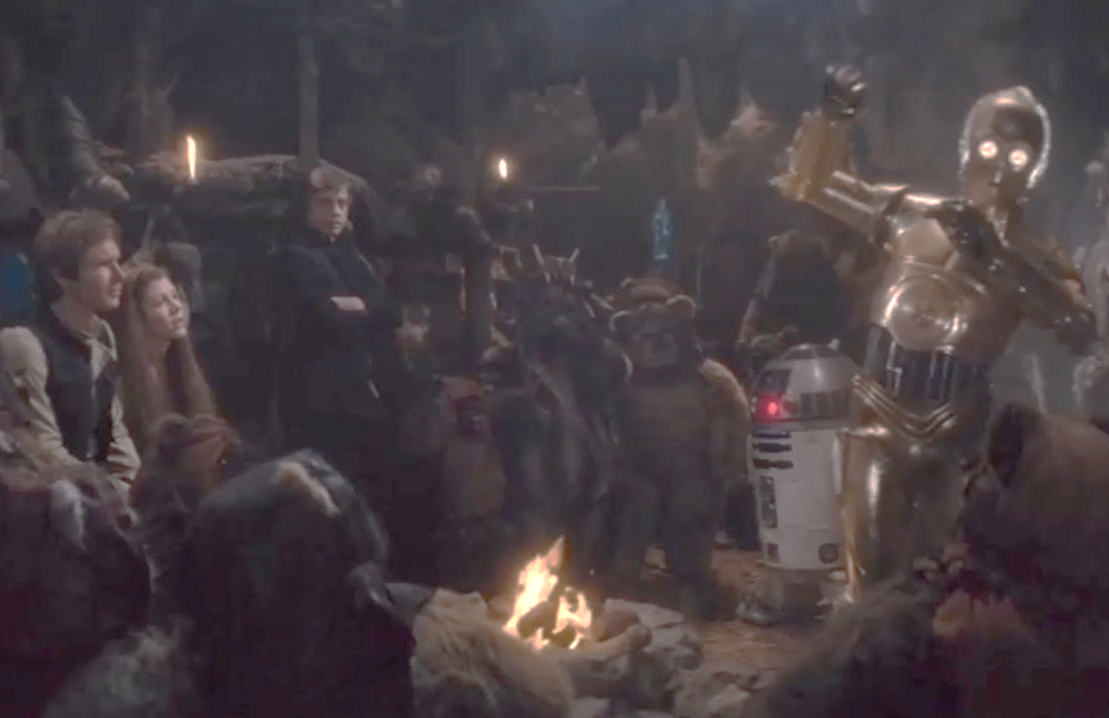
The stage is yours …
Story-TELLING
COMMUNICATING A NARRATIVE
Explains the city of real people, places and emotions
Makes data and decisions relatable
Turns abstract goals into engaging, human-centered stories
Notes:
A way to explain plans and strategies using real people, places and emotions
Makes data and decisions more engaging, understandable and relatable to citizens and stakeholders
Turns abstract policy goals into human-centred narratives that drive interest and action

Slide 20
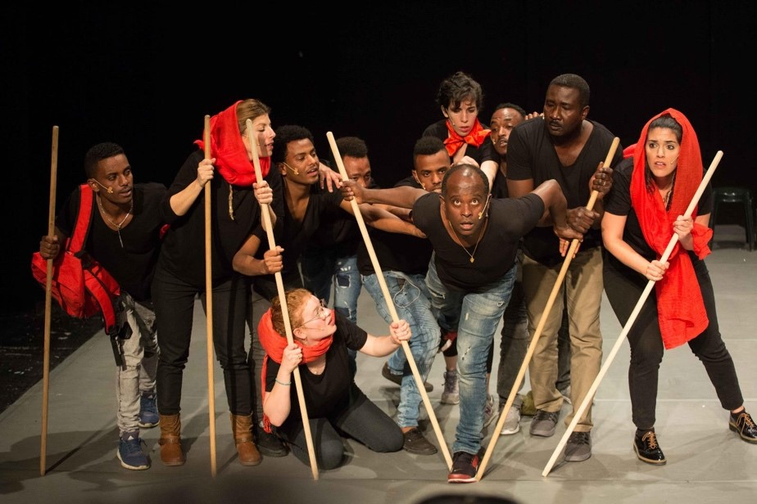
Behind and above …
CO-CREATING NARRATIVES
The story created by/with people involved in or affected by the CHANGE
Gathers diverse voices and perspectives
Builds ownership, trust and authenticity of the story
Story-MAKING
Notes:
CO-CREATING NARRATIVES (WITH CITIZENS, STAKEHOLDERS OR PEERS)
The story created by people involved in or affected by the CHANGE
Gathers diverse voices and perspectives for the story you want to tell
Builds ownership, trust and authenticity of the story

Slide 21
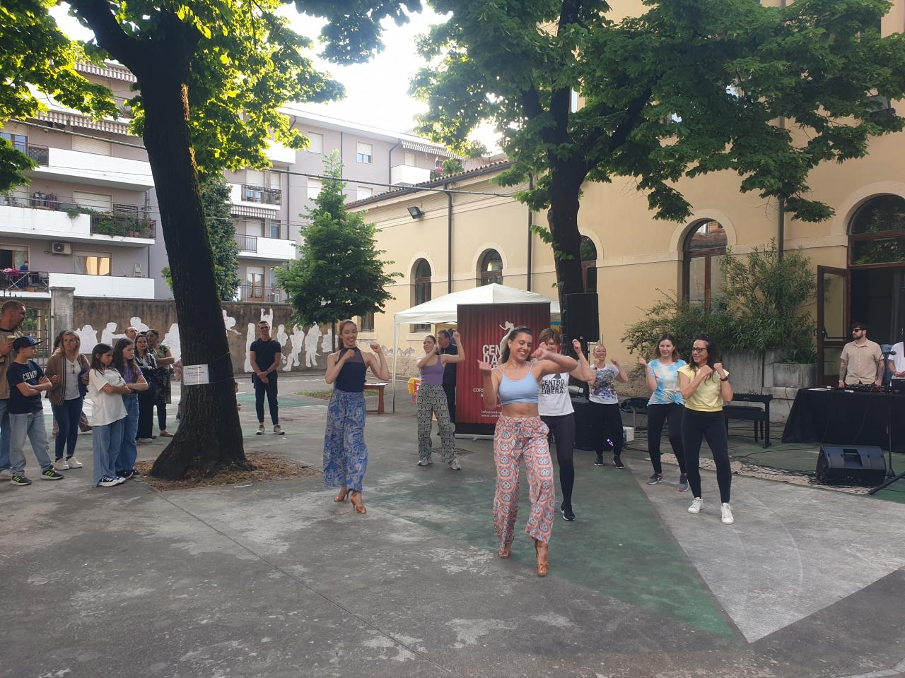
Policy and practice align through narrative
Story-DOING
ACTING IN WAYS THAT EMBODY THE STORY
Letting people experience your story
Uses multisensorial formats for impact in real life
Great for making abstract ideas tangible and memorable
Notes:
ACTING IN WAYS THAT EMBODY THE STORY
Letting people experience your story in action
Uses physical or digital formats to show the impact in real life
Great for making abstract ideas tangible and memorable

Slide 22
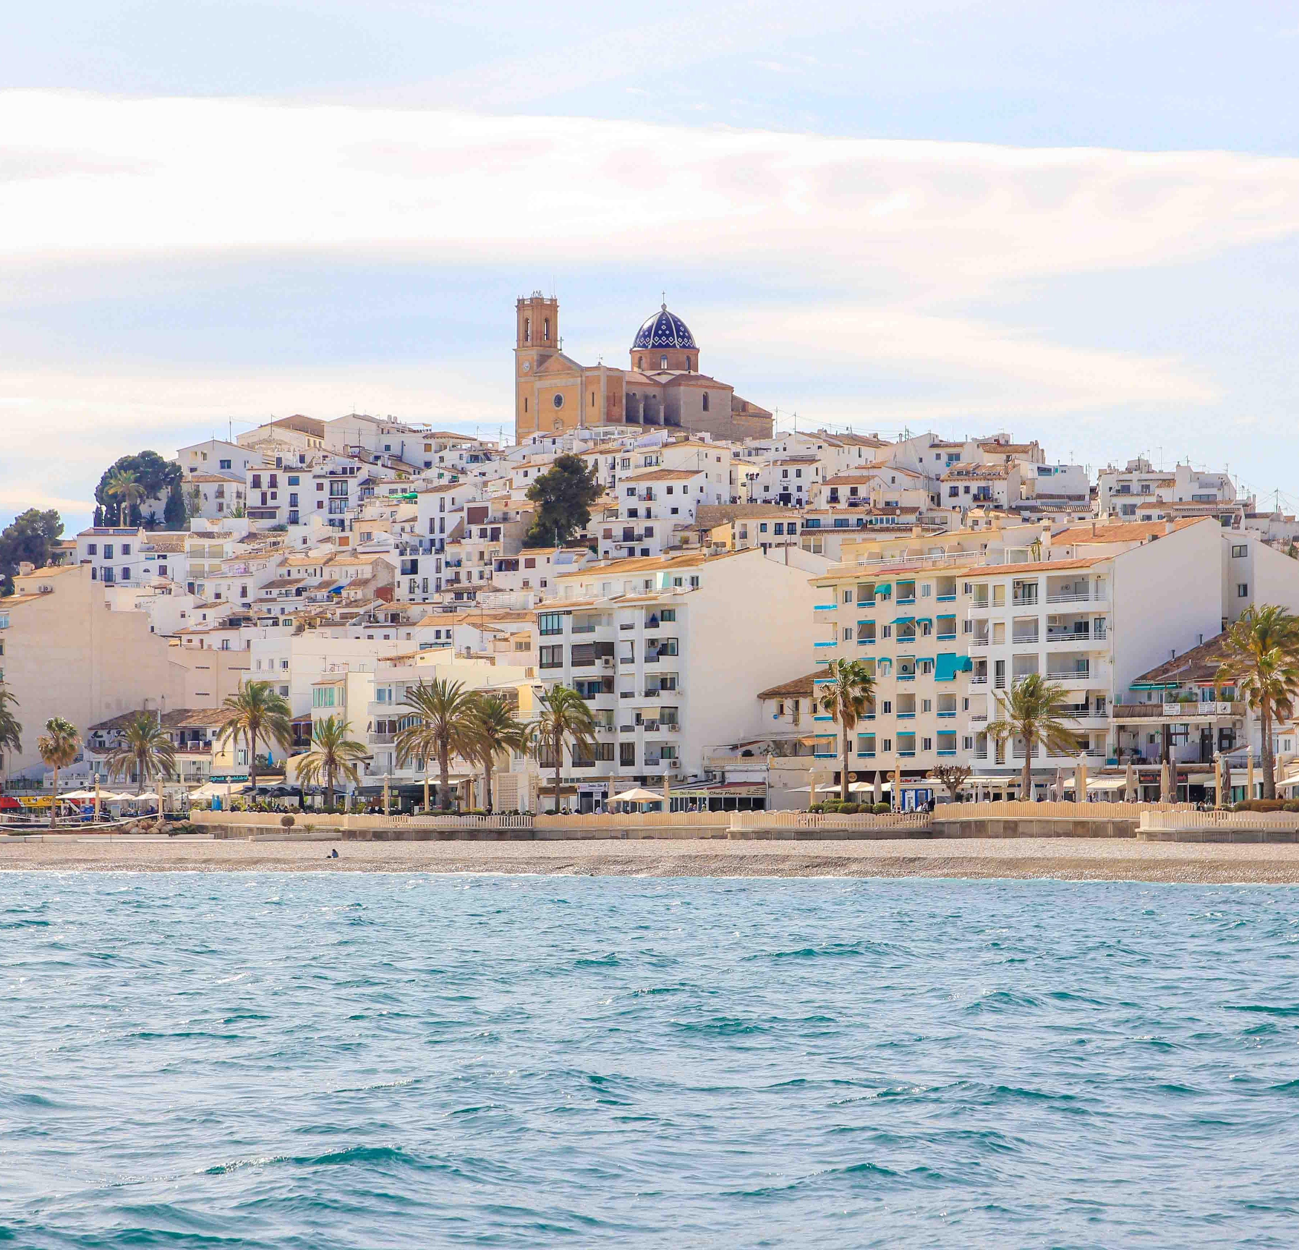
One critical walk in Altea
Paloma Verdù
Municipality of Altea (ES)

Slide 23
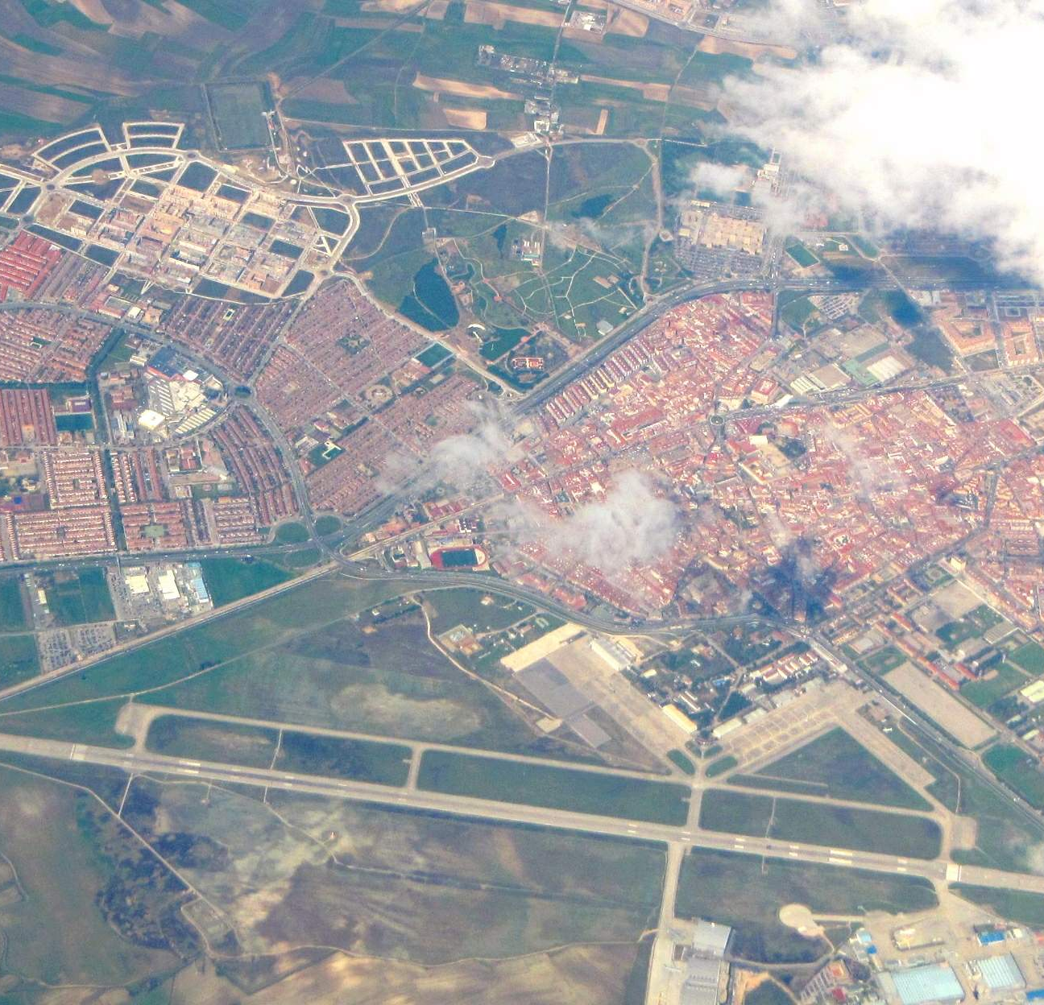




Getafe – a Jane’s walk story
Fernando Gonzales
City of Getafe

Slide 24
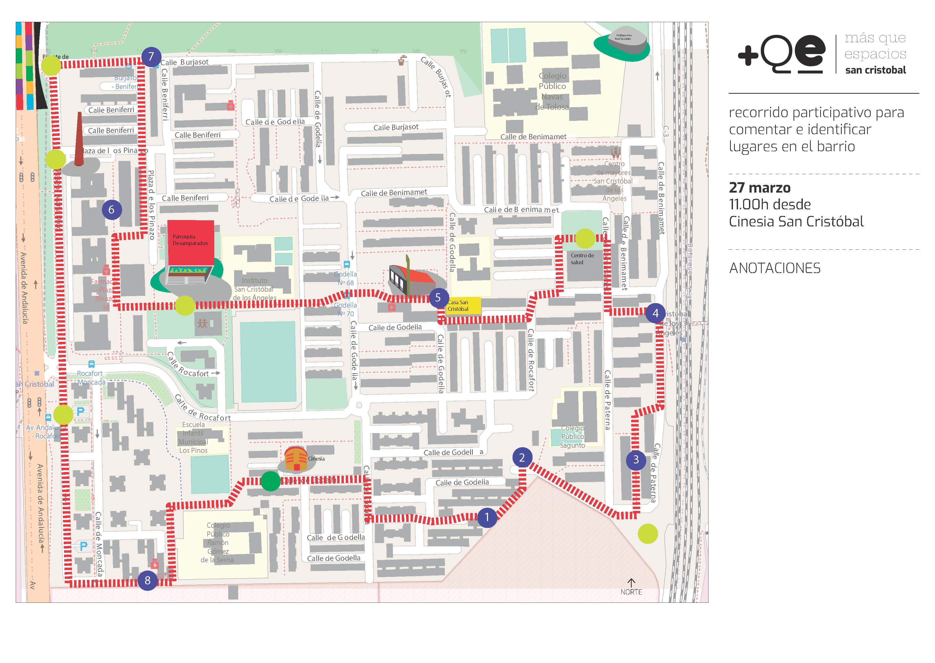
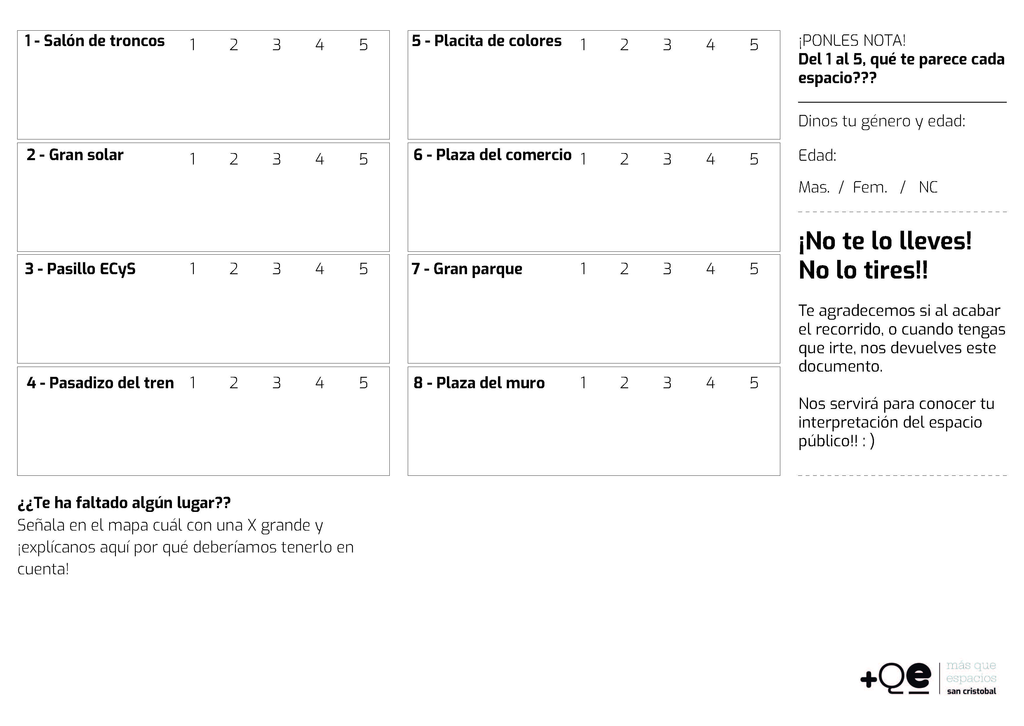
First attempt – focus: Pedestrian spaces in one neighbourhood
· Methodology: The opinions of the residents were also collected on sheets provided for this purpose.
· The Tour: a one-hour walk through the neighbourhood, with POINTS OF ANALYSIS
Notes:
Since 2023, we have used this form of storytelling on several occasions. Some worked well and others not so well. Now we are beginning to understand why.
Our first Jane's Walk was a success, part of the ‘Rehabilitation Tables’ we were developing in Getafe as part of the diagnostic work for ‘Getafe Rehabilita’, our rehabilitation strategy currently under development.
Objective: to recover the idea of the pedestrian in the city. This practice, which is not instrumental in principle, is carried out as an end in itself and will help us understand the importance of distinguishing between the city planned by technicians and regulatory instruments and the experience of the city as practised by users in their daily lives; two intersecting and complementary perspectives.

Slide 25
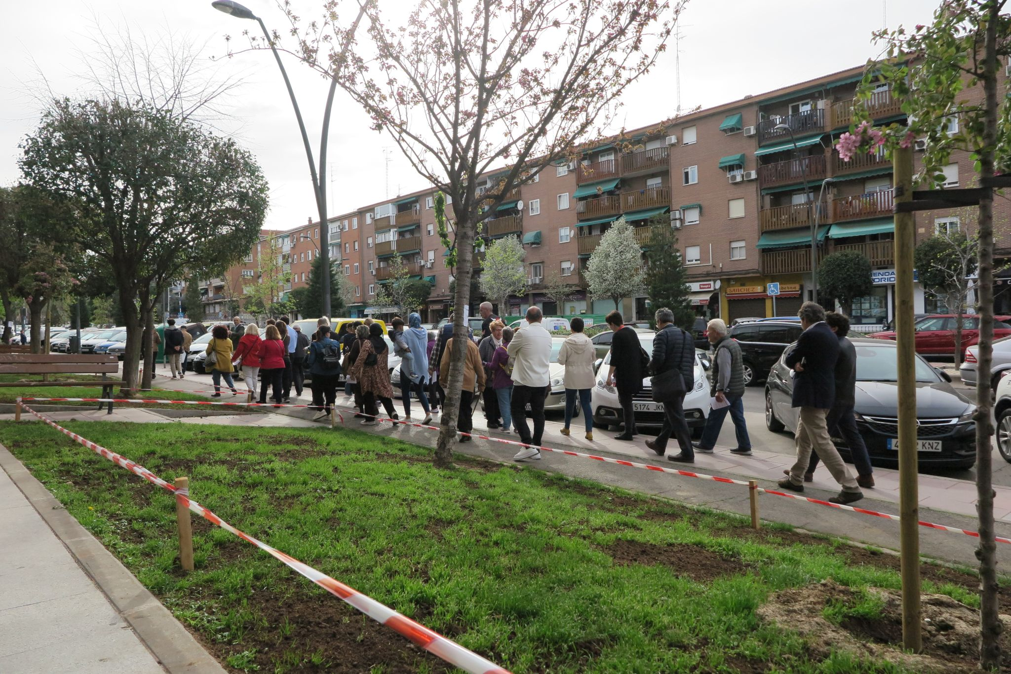
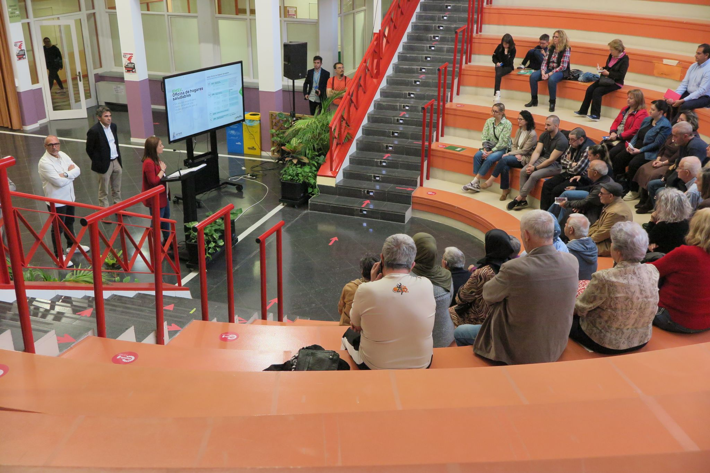
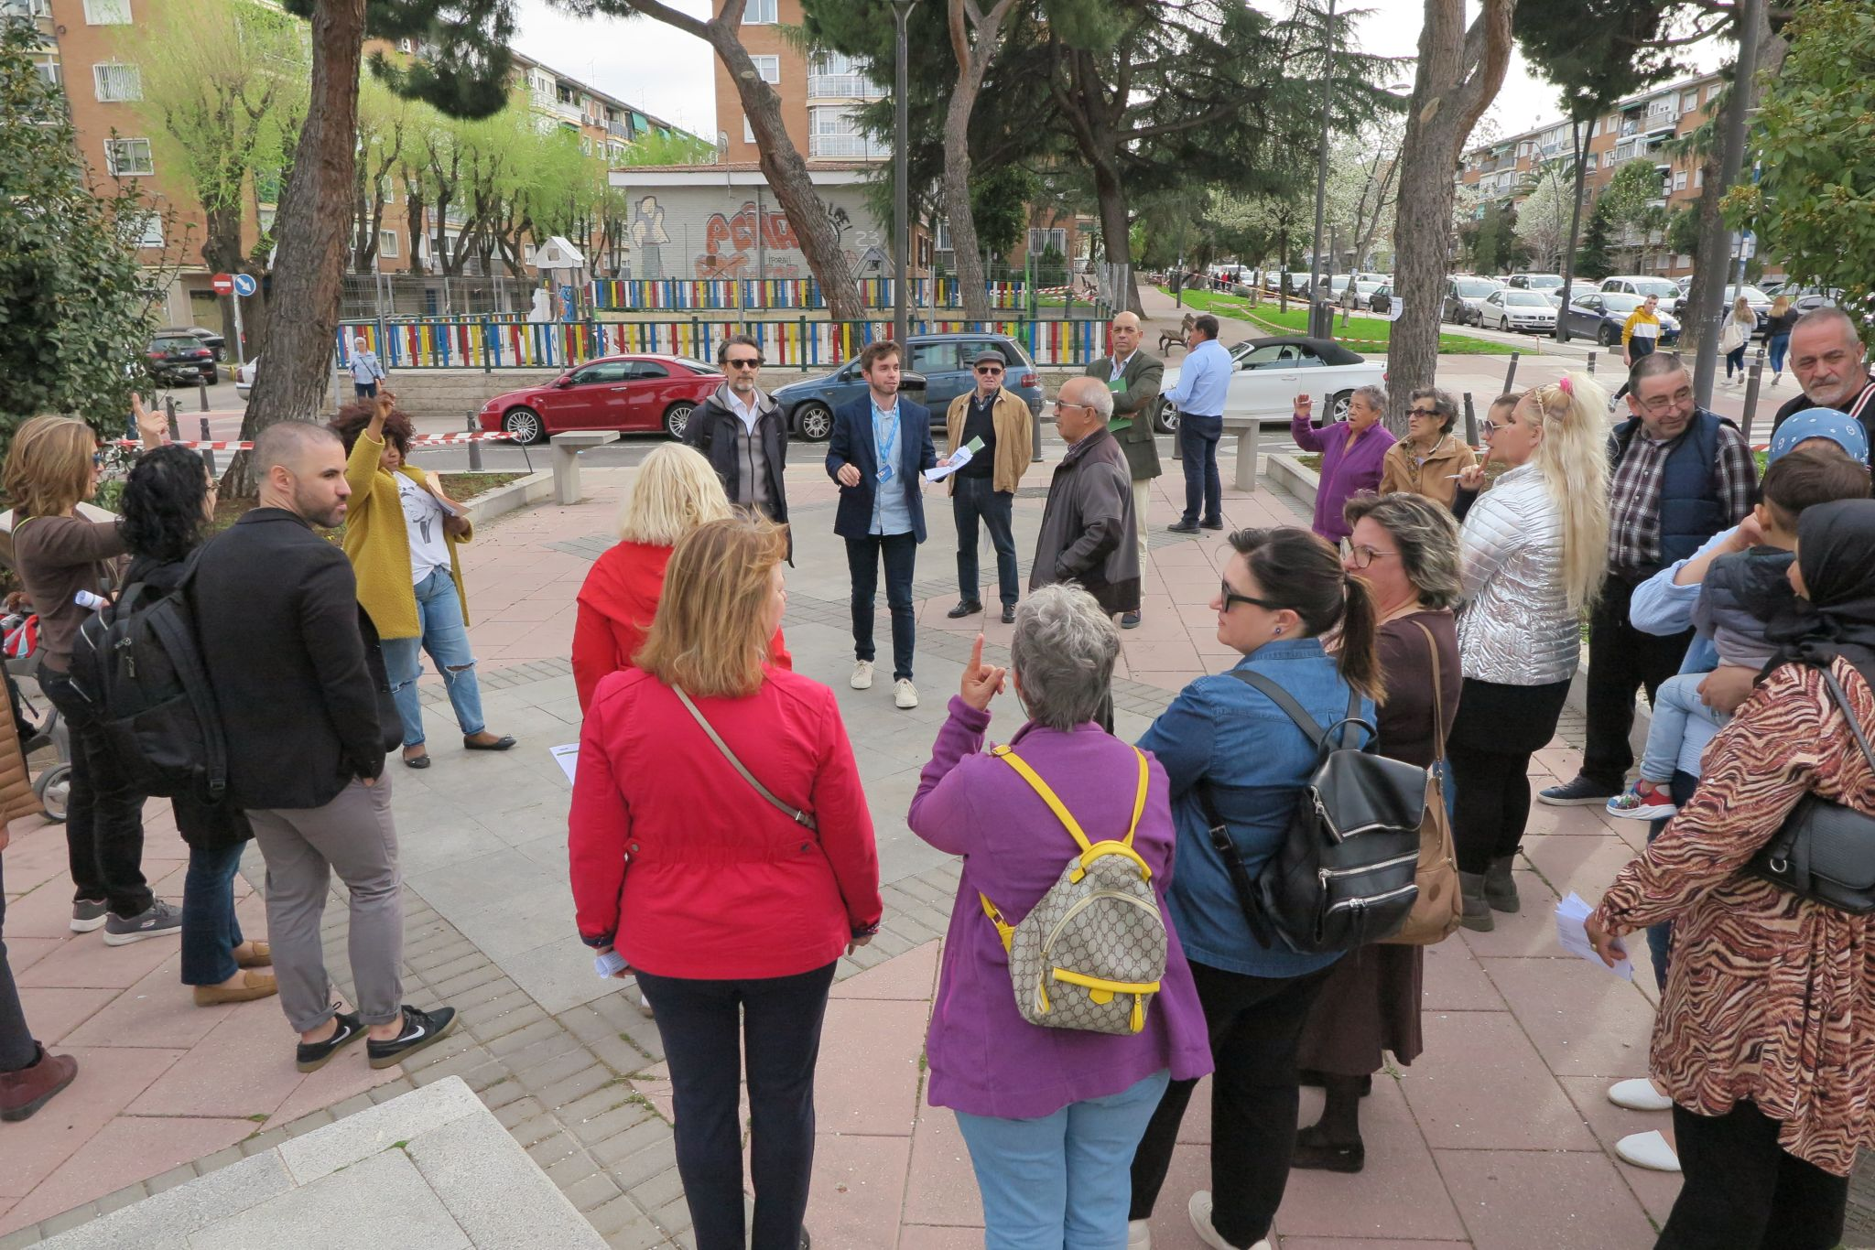
First attempt – a successful tour in the neighbourhood with residents
Notes:
RESULT: SUCCESS!!!!.
The objective focused on the citizen, not on the information.
The tour was well organised and structured, the weather was good, with pleasant temperatures and no rain.
Methodology: correct and effective.
Finale: The mere possibility of being in direct contact with the mayor encouraged participation.

Slide 26
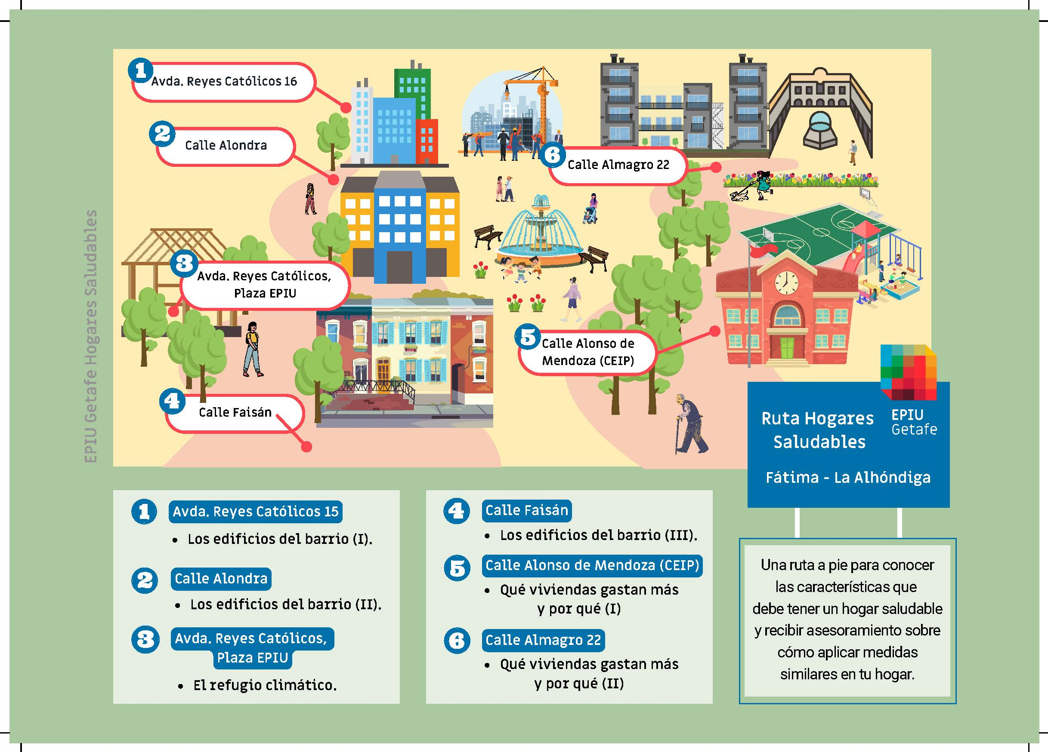

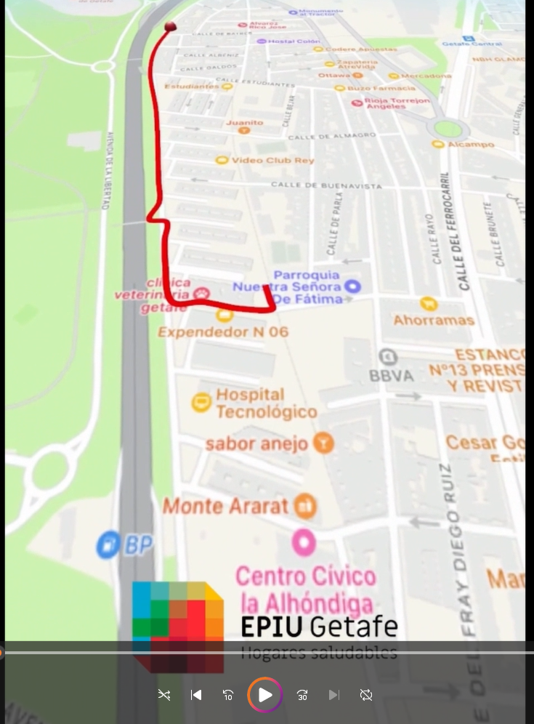
Second attempt- open to all citizens – topic: energy efficiency (Healthy Homes Routes)
Diffusion:
leaflets for social media and paper delivery.
2 videos for social media.
· The Tour: a one-hour walk through the neighbourhood, with POINTS OF ANALYSIS
Notes:
Some time later, in our first European project, EPIU Getafe Healthy Homes, we identified these walks as an excellent opportunity to raise awareness about energy poverty and energy efficiency at the neighbourhood level.
And so we developed our second attempt, in Storytelling, the ‘Healthy Homes Routes’. Two walks through the two neighbourhoods covered by the project.

Slide 27
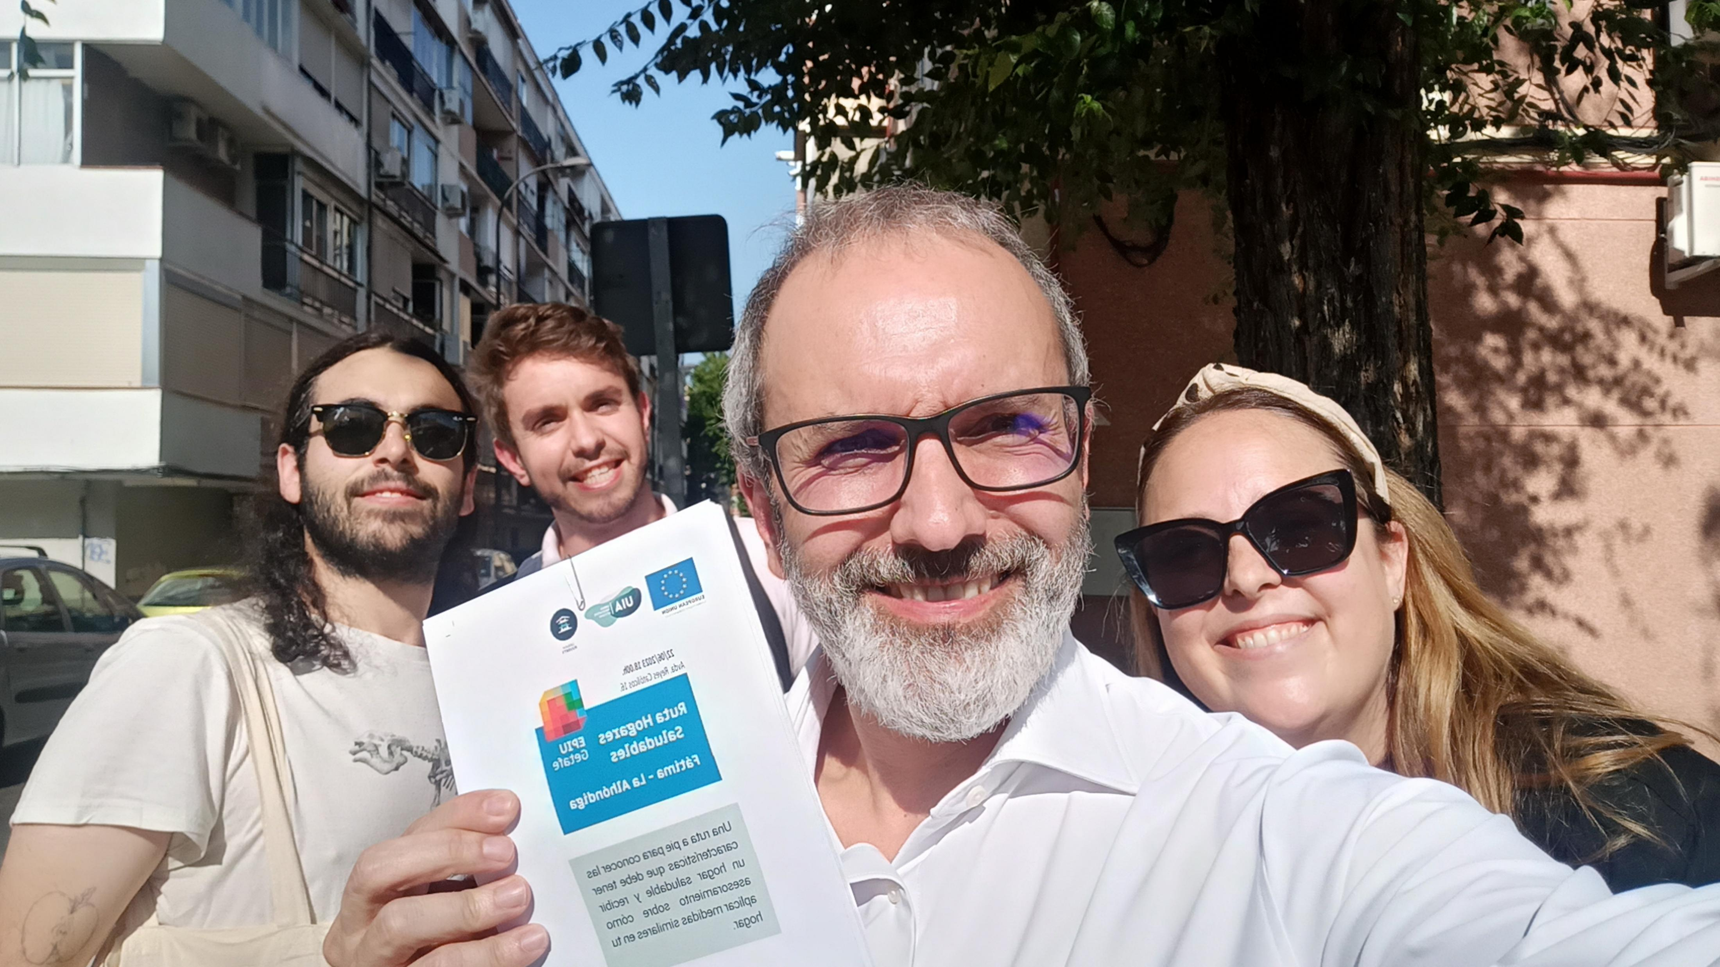
Second attempt- No show!
Notes:
RESULT: FAILURE!!!!
The objective focused on the information. not on the citizen
The tour was well organised and structured, BUT IT WAS BOILING HOT IN SUMMER.
Methodology: correct and effective. (The same)
Given the dates, we did not expect much participation, so without participation, there are no politicians, and without politicians, there is no participation: We failed to meet expectations:
If we had improved our methodology:
Better communication materials, more intensive contact with citizens, or even increasing dissemination through a campaign, I am almost certain that the result would have been similar.
Today I am convinced that if we had done this, we believe there would have been no difference.
The main mistake was to assume that citizens are as interested in receiving information as we are in providing it.

Slide 28
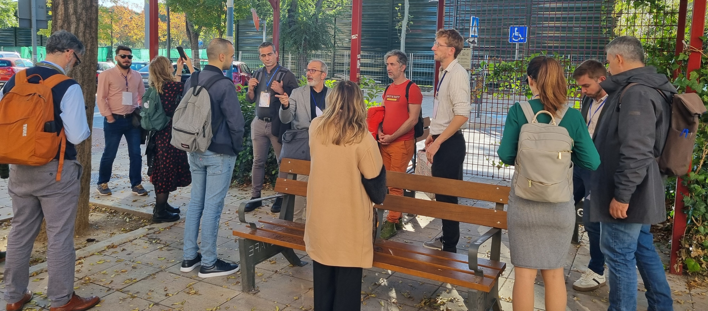
Third attempt- same message, the same content, the same walk of previous one – different audience
Notes:
Third attempt- same message, the same content, the same walk of previous one – different audience

Slide 29
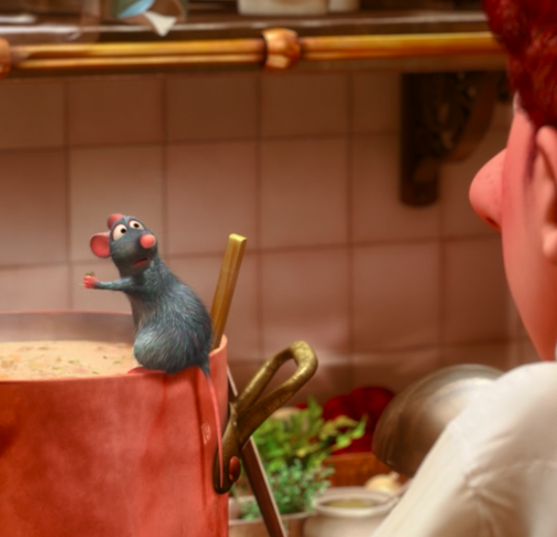
Inside the magic of storytelling
The mechanics or ingredients of (good) storytelling

Slide 30
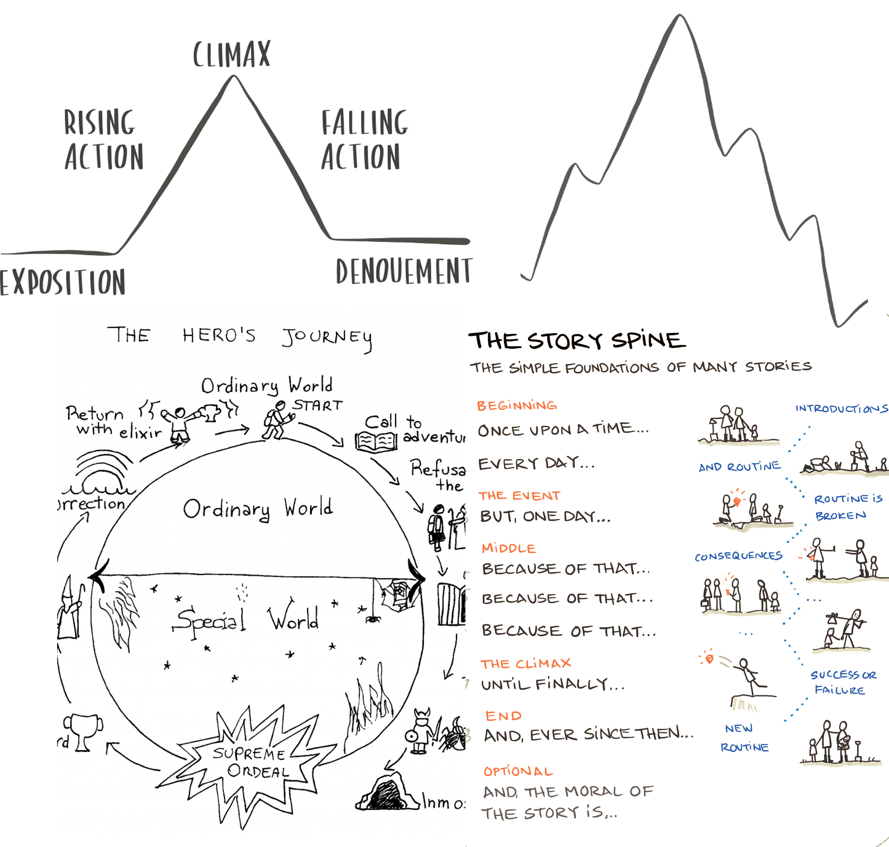
The arc, the mountain, the circle and the spine
Notes:
There are different ways to «codify» or to visualize the elements of storytelling
All are «meta-storytelling», as they include a powerful storytelling tool: the metaphor
The narrative arc
The narrative mountain (which was a pyramid)
The story spine (pixar)
The Hero’s journey

Slide 31
It’s all about change… with 9 key ingredients
Arc / Narrative
A neglected riverfront → years of debates → co-design → a crowded promenade
Hero / protagonist (s)
A group of residents who mobilise neighbours to create an urban garden
Conflict / Opponent (s)
A cycling lane faces opposition from shop owners worried about parking loss

Slide 32
It’s all about change… with 9 key ingredients
Tension / Suspense
The municipality launches a participatory budgeting process for a new playground and two designs compete, one nature-based and the other tech-based
Transformation/ Change
A once-vandalised square becomes lively after youth co-design their sports area
Stakes / Risks
If we don’t use the old aqueduct again our city will pay a higher price for our water scarcity

Slide 33
It’s all about change… with 9 key ingredients
Emotional resonance
A mother enthusiastically explaining how a car-free school area lets her child walk to school independently
Reward
Neighbours meet for the first time at the community picnic after the courtyard has been renewed
Ending / next step /morale
The city has finished the old station renovations, but now residents are invited to co-manage the space

Slide 34
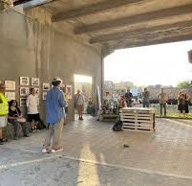
Storymaking in Ravenna
Spot the ingredients and write them in the chat

Slide 35
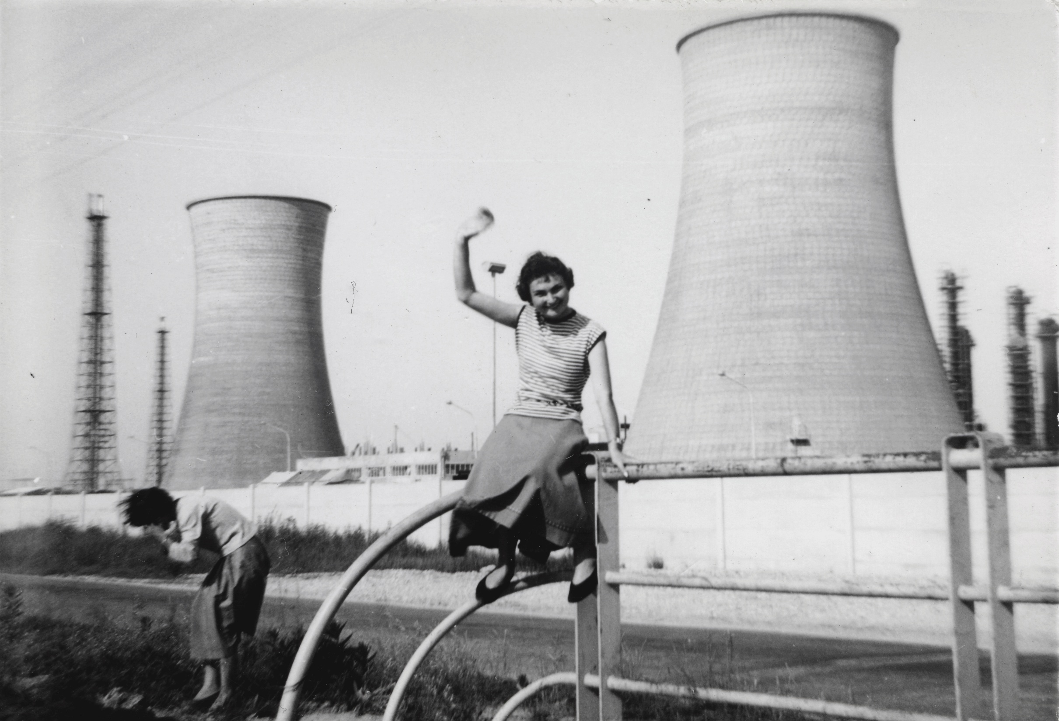

How to use storytelling to engage citizens in local projects

Slide 36
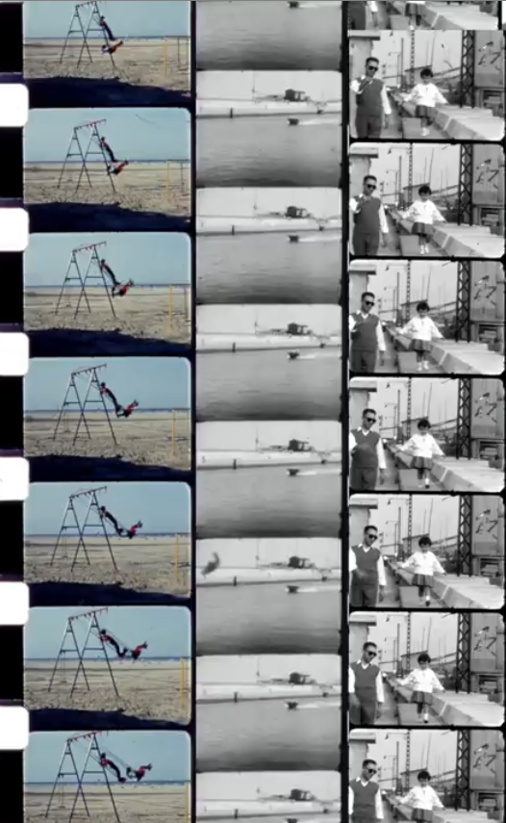
COLLABORATIVE STORYTELLING TO ENHANCE CITIZENS CENTRIC URBAN REGENERATION
OUR CHALLENGES:
design narration of the evolution / change of an urban neighborhood
discover / rediscover the stories of residents;
enhance ownership / identity of the place
DARE set up various activities aimed at telling stories: video interviews, podcasts, storymaps, guided tours…
CREATING A SENSE OF PLACE THROUGH LOCAL MEMORIES AND STORIES

Slide 37


UNROLL THE MEMORY
Public call for the collection of amateur and family films in Ravenna

Slide 38
WHAT WE ASKED FOR?
> Amateur and family films in 8mm, Super 8, 16mm, and 9.5mm formats
> Amateur and family videos (Video8, Hi8, BVU, etc.) made in the areas of the Darsena
> Family and amateur photographs

Slide 39
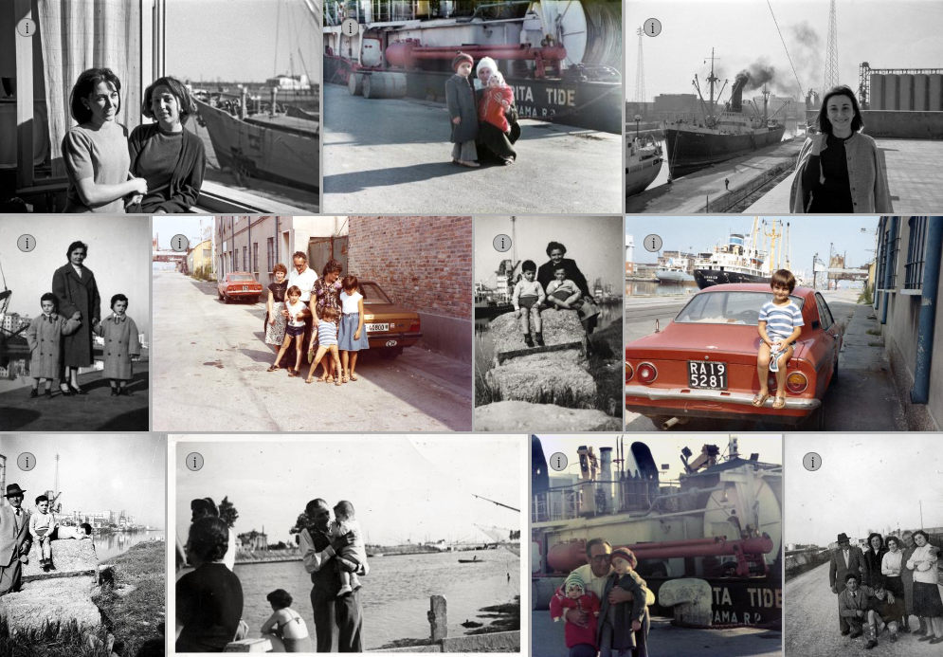
THE DARSENA AS A SET
The Darsena, with its distinctive industrial beauty, has often been used as an effective backdrop for countless family photos during outings and Sunday walks

Slide 40


From 20 May to 19 June 2022, the Darsena district of Ravenna was transformed into an exhibition space with 5 site-specific shows spread across locations where cultural events do not usually take place:
a perimeter wall along the Candiano Canal
the historic headquarters of the National Shooting Range
a social housing apartment
a garden in public housing
the grandstand of the former racecourse

Slide 41
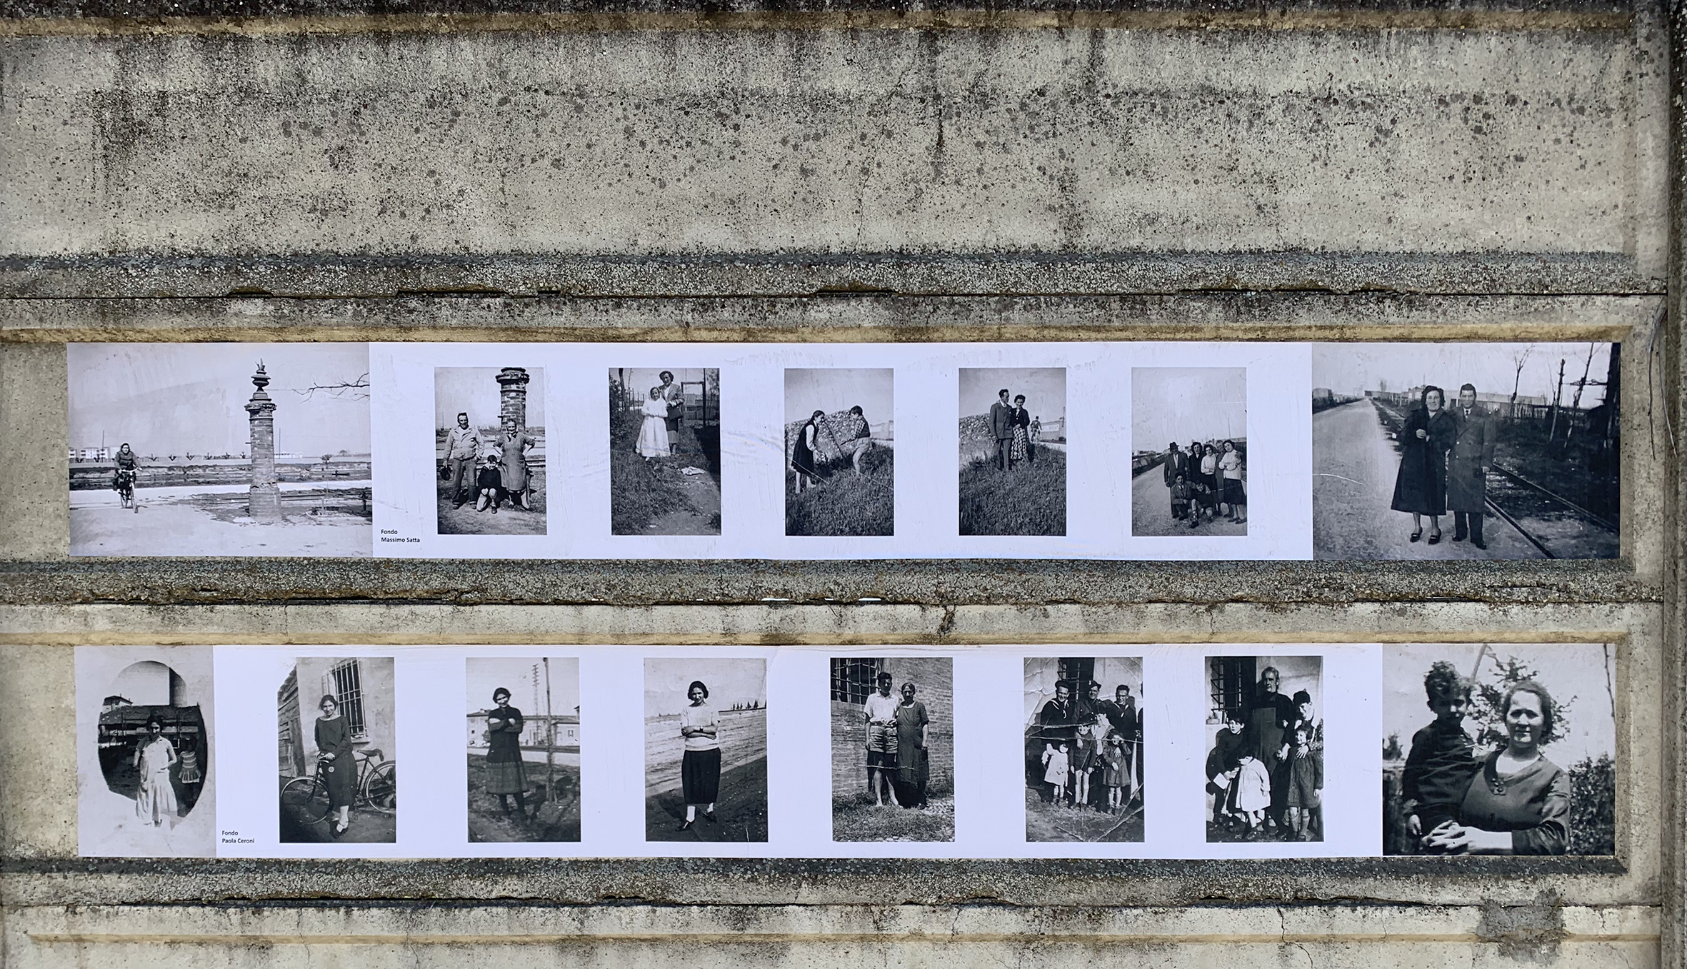
THE SETRAMAR WALL
Large-scale photographic reproductions displayed on a perimeter wall surrounding a company’s premises, telling the stories of people’s bonds with a dense and layered area such as the Darsena: a place of production and work, strongly marked by its industrial character, yet also a place to live—a living space where one can walk, stroll, and play

Slide 42
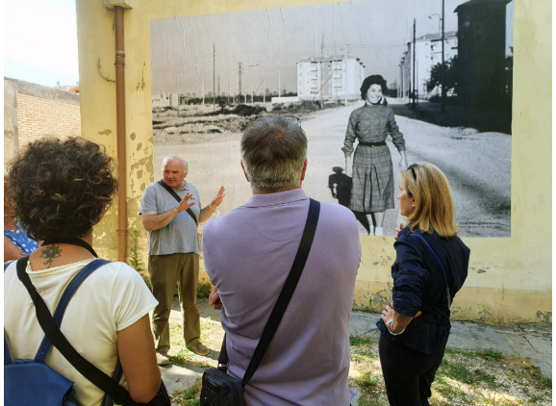
COURTYARD IN VIA FIUME
An exhibition of large-format images posted on the walls of a building, with others placed among the green flowerbeds—photographs that emerge like wild grasses and spontaneous flowers, representing moments of family everyday life experienced outside the home
DARSENA CITIZENS WERE OUR GUIDES

Slide 43
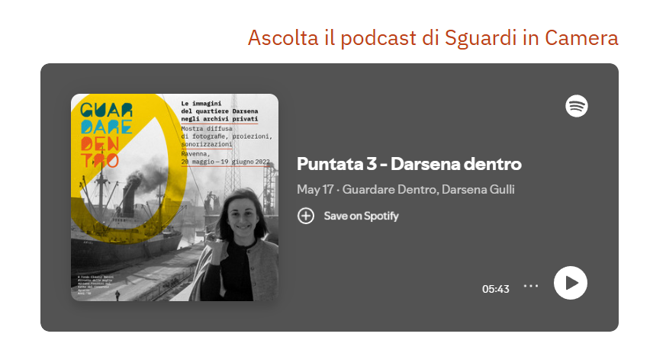

Slide 44
How to engage with us?
1. Through Wooclap
2. Through Questions & Answers option on ZOOM

Slide 45
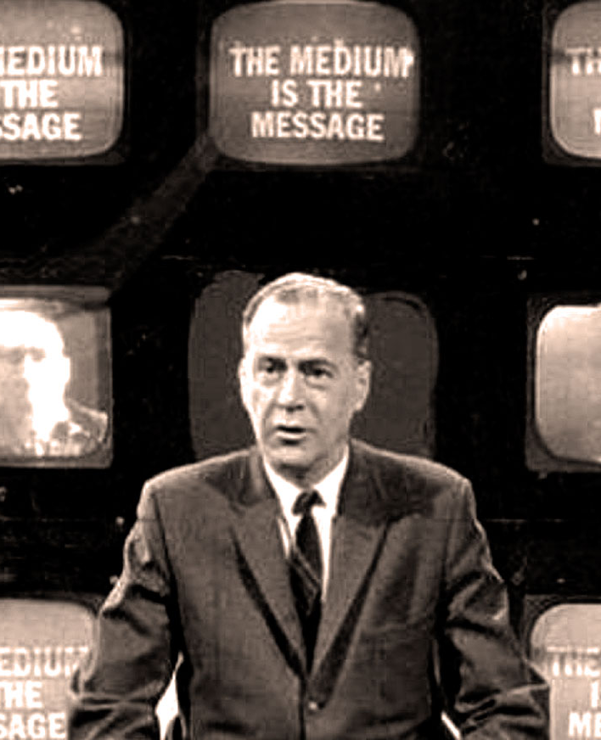
THE MEDIUM IS THE STORY
Techniques and forms of city storytelling –
Examples from cities
Notes:
Each format reaches a new/different audience
Each version deepens your own understanding
The format you choose = part of the message

Slide 46
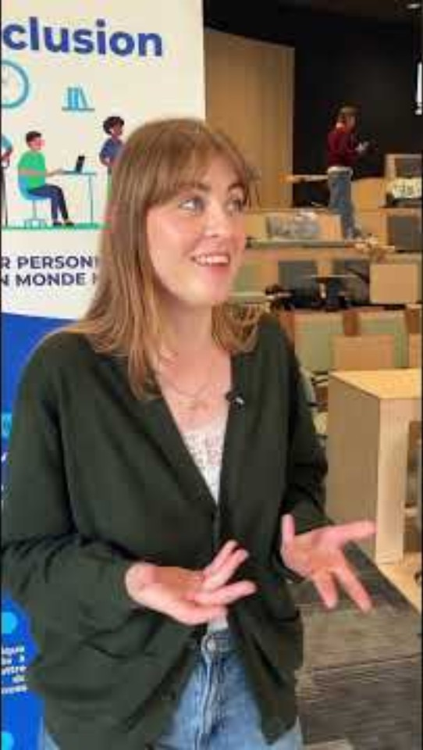
Short interviews, documentaries, social reels
Example:
Digi-inclusion URBACT Network

Slide 47

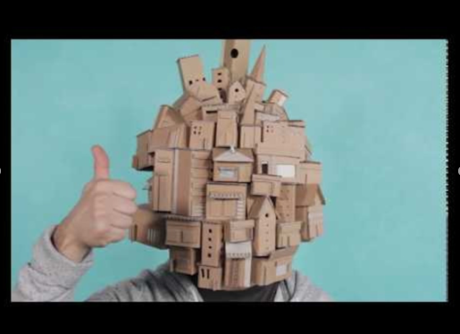
video animation by the URBACT Retailink network

Slide 48
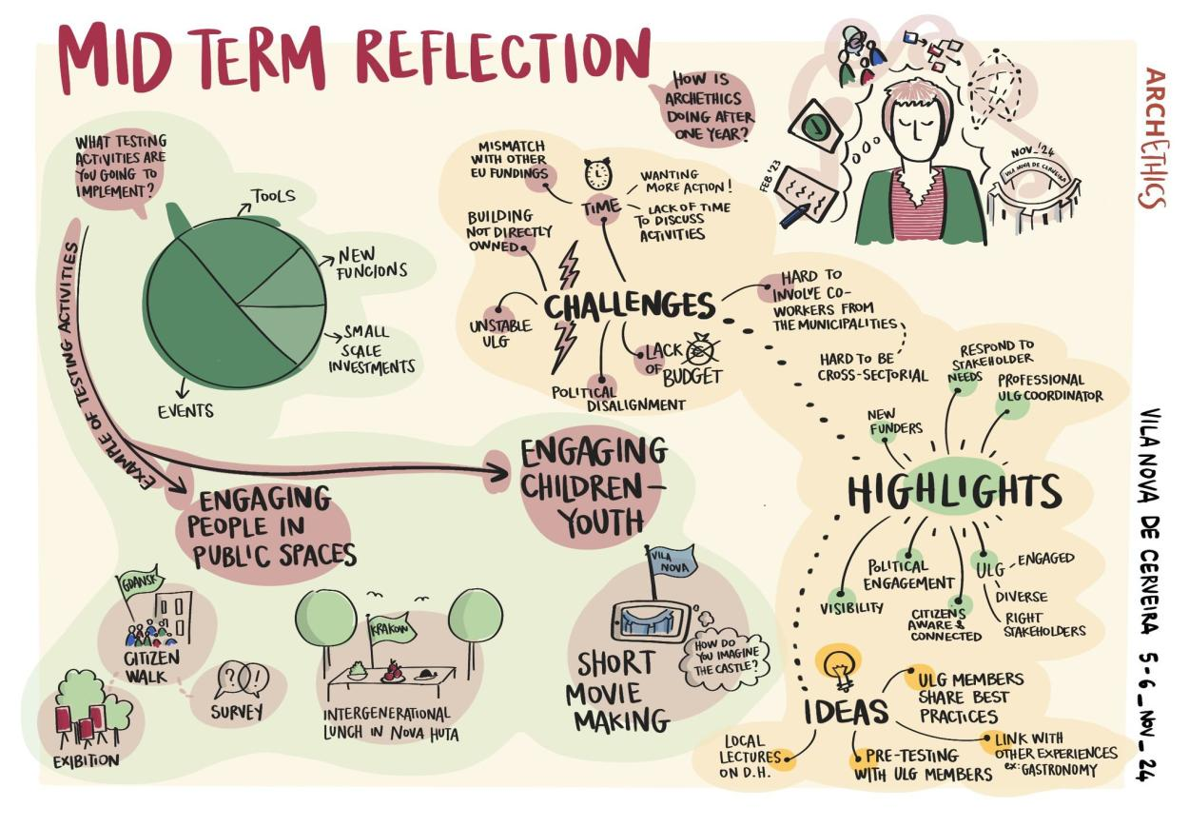
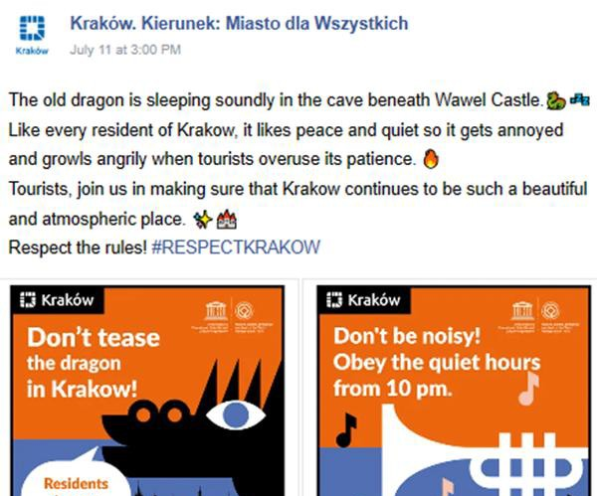
Visual storytelling
ARCHETHICS (DISSONANT HERITAGE)
KRAKOW CAMPAIGN FOR NIGHT’S BEHAVIOR
Notes:
The dragons are us

Slide 49
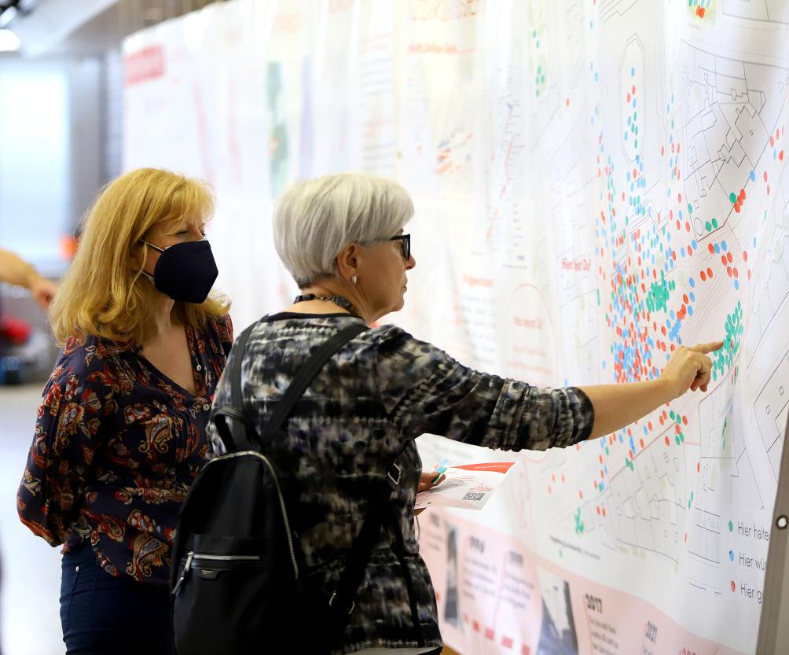
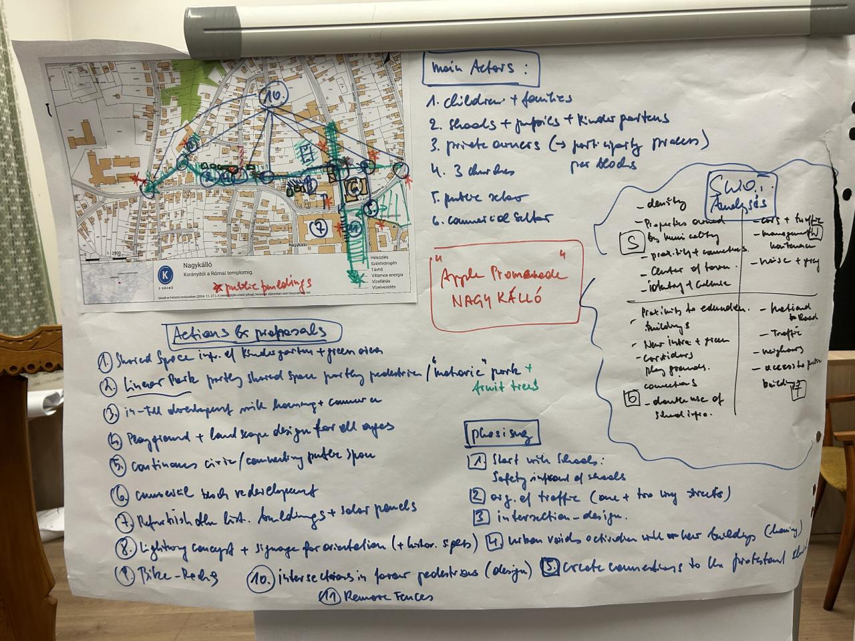
Mapping as storytelling
ECOCONNECTING URBACT NETWORK
Notes:
Econnecting URBACT

Slide 50
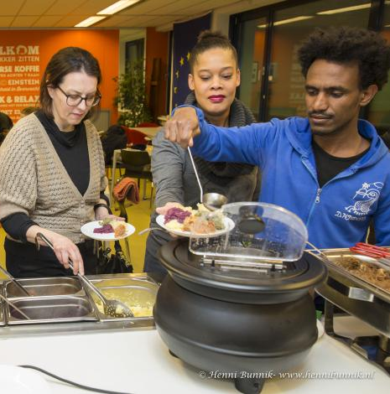
Public events, citizens’ storytelling, podcast, hackathons
UTRECHT – FOOD STORIES
VERONA – STREET CULTURE (RE-GEN)
Notes:
Verona – the street was once neglected and now is a space for dancing
Weldi – food tells the stories of people

Slide 51
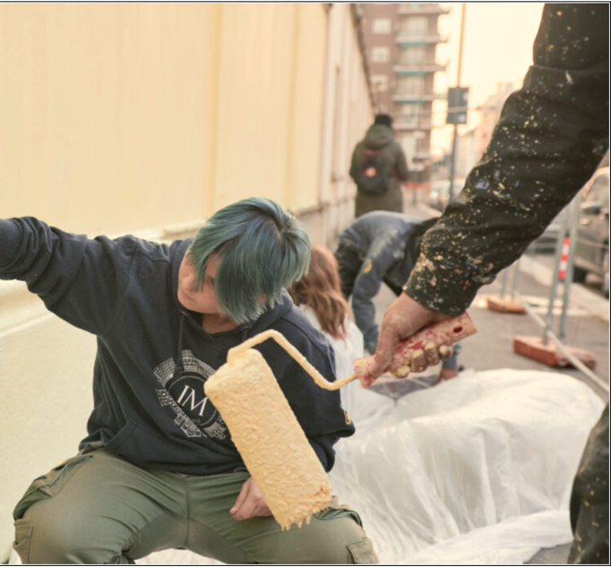
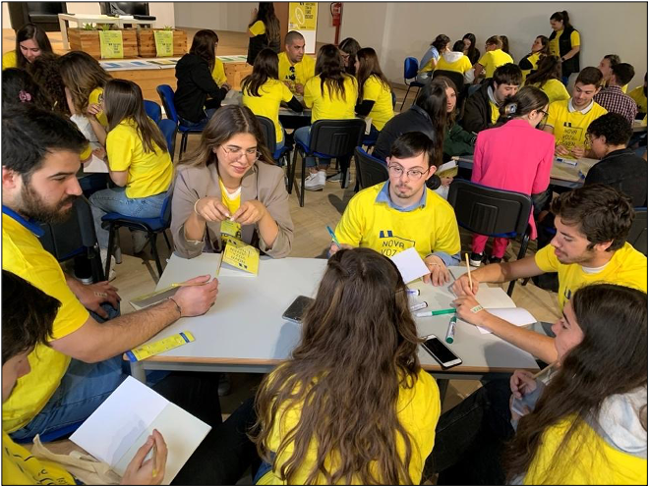
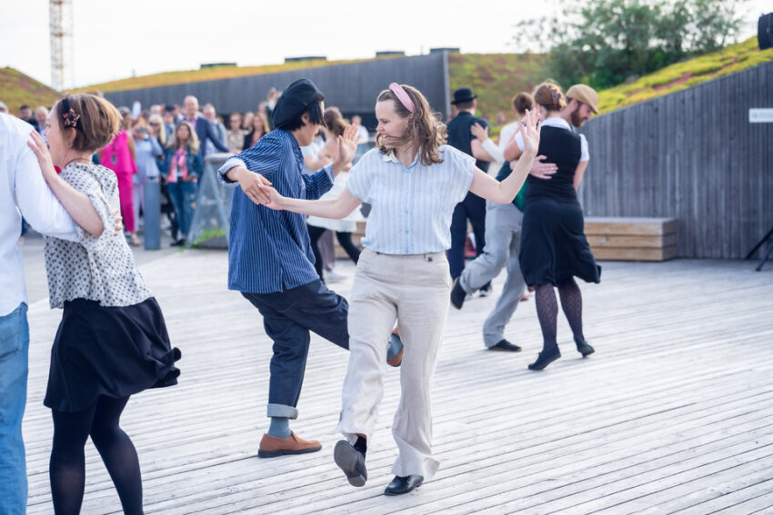
MILANO – YOUTH ENGAGEMENT – WISH CITIES
HACKATHON- Vila Do Conde
URBACT UNIVERSITY - MALMO
Notes:
Milano wish – now I can colour the buildings instead of playing games
Working together on a challenge: creating a story for the school yard
urbact university

Slide 52
Data and jargon unfolded
Notes:
Two articles
Telling the story of a music school’s educational approach through the performance of a kid with migrant background
Talking about mobility to anf from school through the story of a pupil

Slide 53
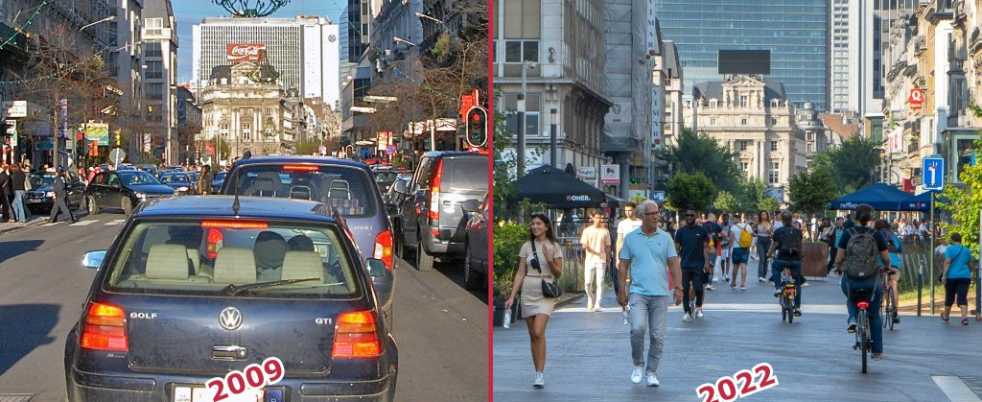
Before- after – Boulevard Anspach Brussels

Slide 54
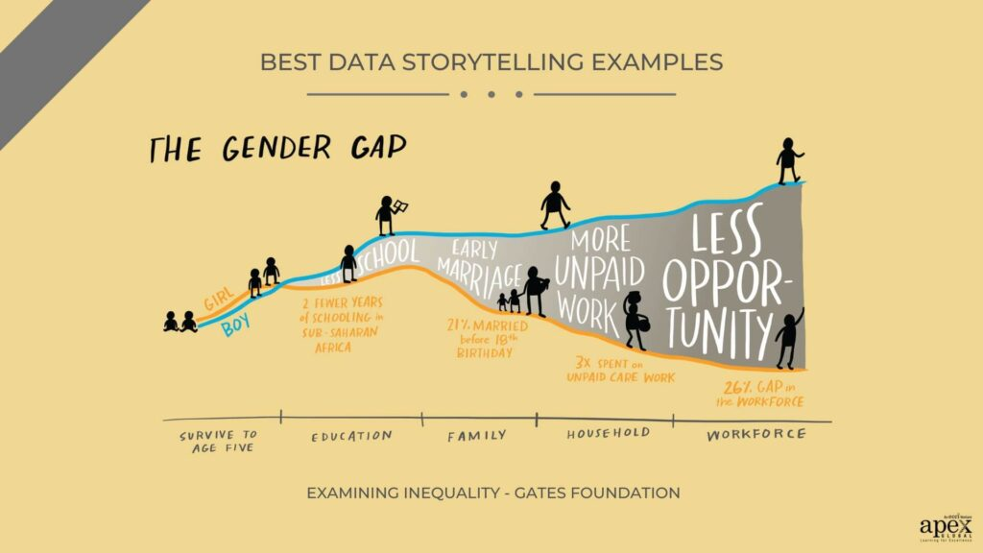
Data explained
Notes:
Gender gap: The Gender journey in different dimensions of life through visuals

Slide 55
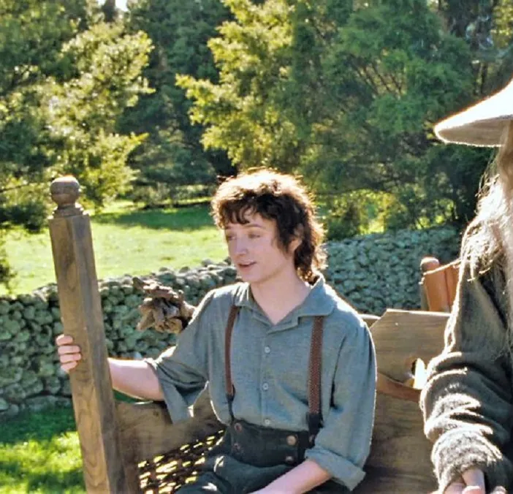
It’s the small things, everyday deeds of ordinary folk that keep the darkness at bay
Gandalf, The Hobbit: An Unexpected Journey (2012)

Slide 56
Five tips to start building your storytelling practice
1. OBSERVE
Observe your “story-worthy” moments
2. EXPERIMENT
Experiment with formats to attract and retain diverse audiences
3. AUDIENCE
Build a small habit: Who am I speaking to? What do I want them to feel or do?
Notes:
Observe
Observe your “storyworthy” moments
Which meetings, reports or presentations could benefit from a more narrative approach?
Experiment
Experiment with formats
Try adding a visual metaphor, a short citizen story or a simple before/after example
Build
Build a small habit
Start every message by asking: Who am I speaking to? What do I want them to feel or do?

Slide 57
Five tips to start building your storytelling practice
4. TOGETHER
5. AT EACH STEP
Share and learn together- collective storytelling is more powerful
Celebrate progress and analyze the reasons why it resonates with others
Notes:
Together
Share and learn together
Storytelling grows faster in teams, it builds on collective intelligence, collect local stories and practice empathy
At each step
Celebrate progress
Every time your message reaches someone more clearly, that’s storytelling at work, take stock for the future

Slide 58

The Force will be with you. Always
Obi-Wan Kenobi, Star Wars: A New Hope (1977)

Slide 59
How to engage with us?
1. Through Wooclap
2. Through Questions & Answers option on ZOOM

